Slide 1
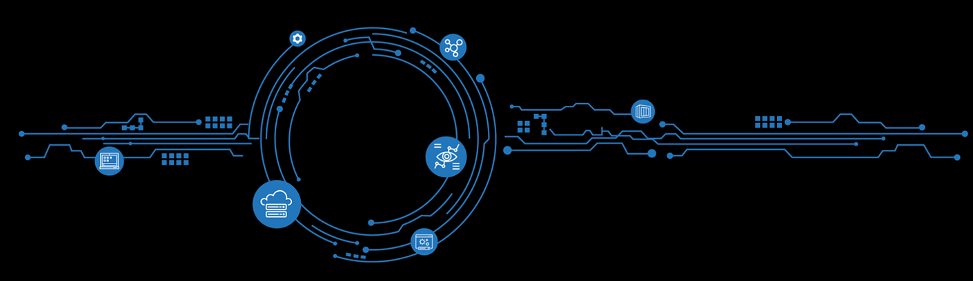
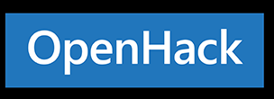


DevOps
Coaches Guide
#MSOpenHack
Notes:
Welcome to OpenHack!
Thank you for being here!
My name is Tristan Gorringe, I’m a PM in Commercial Software Engineering and I’ll be leading you through the OpenHack experience along side Dariusz Porowski who is an Engineer also in CSE
How many are attending Ready for their first time?
How many are attending their first OpenHack?

Slide 2



What is OpenHack?
Customers/Partners
Challenge Based: increasing difficulty
Team Based: work together and communicate
Immersive: real-world scenario
Feedback: improve product offerings through a direct feedback loop with Engineering and Documentation
Notes:
What is OpenHack?
Challenged based – increasing difficulty
Team based – work together and communicate, your team is your family for the next two days
Immersive – real-world scenarios
Feedback – improve product offerings through direct feedback loop with engineering and documentation

Slide 3
Coach responsibilities

Slide 4
How do the coaches support success?
Hacker Team(s) |  | Manage Sentiment |  | Coach Team
Facilitate collaboration Set expectations Ask leading questions, offer resources instead of answers* Encourage creativity Problem solve, both technical and interpersonal |  | Content will be challenging and frustrating at times Let them be challenged but not blocked Check in frequently and raise any issues or what is working well |  | Share challenges, solutions Leverage Teams channel Collect daily feedback for end-of-day coaches' sync Take breaks and check in with the coaches around you

Slide 5
For the internal coaches sync at the end of each day, these are questions you should ask each of your teams:
What did you accomplish today? | What was the biggest challenge today? | Is there anything we can do better tomorrow?
Note: As a coach, you should lead a retrospective at the end of each challenge.

Slide 6
OpenHack Event Code of Conduct
Microsoft’s mission is to empower every person and every business on the planet to achieve more. This includes at OpenHack where we seek to create a respectful, friendly, and inclusive experience for all participants.
As such, we do not tolerate harassing or disrespectful behavior, messages, images, or interactions by any event participant, in any form, at any aspect of the program including business and social activities, regardless of location.
We do not tolerate any behavior that is degrading to any gender, race, sexual orientation or disability, or any behavior that would violate Microsoft’s Anti-Harassment and Anti-Discrimination Policy, Equal Employment Opportunity Policy, or Standards of Business Conduct. In short, the entire experience at the venue must meet our culture standards.
We encourage everyone to assist in creating a welcoming and safe environment. Please report any concerns, harassing behavior, or suspicious or disruptive activity to venue staff, the event host or owner, or the nearest security guard or event staff.
Microsoft reserves the right to refuse admittance to or remove any person from OpenHack at any time in its sole discretion.

Slide 7
We ask you to take a leadership role in helping to ensure this event is a success for your peers and our customers. How you can help:
Prioritize the satisfaction of our customers and partners above all else. Extend your kindness and courtesy to all other attendees and help event staff as needed.
Ensure all attendees are respectful and supportive of other attendees. If someone is being excluded, ignored or interrupted, please take time to politely direct the group to be respectful. E.g. “I don’t think they have finished their thought”
Immediately report any incidents to the Event Crew that are harassing or disrespectful regardless of gender, race, sexual orientation or disability.
Remember that while there will be a number of Microsoft employees hacking through the challenges, the majority of attendees are external. Please refrain from discussing any Microsoft confidential information at the event or ancillary activities.
Do not use open forums with Microsoft SMEs (e.g. lunchtime presentations) to ask internal or “Hardball” questions. Microsoft attendees should instead find private time to ask these questions or provide feedback.

Slide 8
Some things to keep in mind...
No step-by-step instructions or “right” answer
Not all pain points are removed
Everyone should be learning and having fun. That includes YOU!
Keep challenge content and reference solutions private
Teams probably won’t complete all challenges. It’s important that they learn to not cut corners, it’s ok for them to stay in the early challenges, and the objective is not to finish all challenges
A team that completes Challenge 5 has completed the core challenges
There are ways to make it better which is what challenges 6, 7, and 8 all are about.

Slide 9
Couple more things to keep in mind…
If your table has a Microsoft or MVP participant that is already experienced with Azure and migrations, chat with them about giving the others in the team a chance to lead instead of leading the pace and solving everything
If there are follow up opportunities for the local CSE team, please raise that with organizers so they are aware and can plan for it
At the beginning of each challenge give an overview of what the challenge is about without giving answers
This is your opportunity to set clear expectations with your table about what you want to see!
Help collect feedback; be descriptive, get screen copies, don’t depend on attendees to fill out the feedback
Even though we have a leaderboard, we won’t have it up all the time and it’s important that they learn and not cut corners.
It’s ok for them to stay in the early challenges, and the objective is NOT to finish all challenges!
Notes:
Before diving in to specifics of the challenges, let’s take a moment to address some high level items that have come as a surprise to some people and were sometimes interpreted as an oversight.
There is a perception that only Microsoft technology works on Azure. The heavy use of OSS in this hack will hopefully help to dispel this idea while giving an opportunity for attendees to learn about the most common ML/DS libraries.
While there is definitely a use for tutorials that take a step by step approach, the focus of an OpenHack is to encourage creativity.
There is frustration that is inescapable with ML. There are some pains that we have worked to ease as much as possible, but there is value in attendees struggling with a problem and then overcoming it.
Scikit-learn gives newcomers an introduction to ML and the related vocabulary without also having to navigate something cumbersome such as TensorFlow. Many ML tools clone or imitate this API. There are scikit-learn models in production and scikit-learn models are common in ML on the edge scenarios.
This event is not meant to be completed by everyone. It is not a bad sign if you know your team won’t finish. The best possible outcome of this event is that everyone has learned more about ML and how to move forward with their real life projects.

Slide 10
Final things to keep in mind
The OpenHack challenges vary in difficulty, with some easier ones in between; so ensure you are prepared to support your hackers and review the challenges again
Spend some time at the beginning of each challenge to give them an idea of what the challenge is about
Monitor usage of the subscriptions, don’t let them go nuts on it
Remind them often to check the references at the bottom of each challenge

Slide 11

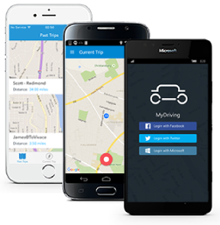
OpenHack Theme
Your team is the IT team of a fictitious insurance company that runs the MyDriving Service.
The company is offering their customers the ability to evaluate their driving skills.
A mobile application collects the data from the car and sends them to a set of APIs which evaluate the trip that has just been completed.
Your customers can connect to a web application that uses the same APIs to review their trips and their driving score. Any downtime of the APIs would greatly impact your business.
Your mission, should you accept it, is to update the APIs to incorporate any business requirements while keeping the application functional.
The success of your team depends on your ability to perform those updates by applying DevOps focused practices to build, test, deploy, and monitor the MyDriving Services. If done properly you will not incur downtime and have visibility of your application throughout the entire process.
Notes:
Your mission, should you accept it, is to update the APIs to incorporate any business requirements while keeping the application functional.

Slide 12
DevOps is a team sport 1 - People 2 - Process 3 - Technology

Slide 13
Challenge Walkthrough
Notes:
We’re going to walk through the challenges in the order the teams will see them during the event. Think about your approach to these challenges and how you are planning on assisting your team as they move through them. Is there an area you have a lot of experience? For each challenge, we will take a moment for people to identify technology/concepts they are deep in and they will be someone who can be available for back up to a coach with less experience in a specific area.
If there is an aspect of a challenge where you would like to know who to ask questions of and we don’t cover it, let us know before we move on so you can have the resources you need for a successful hack.

Slide 14
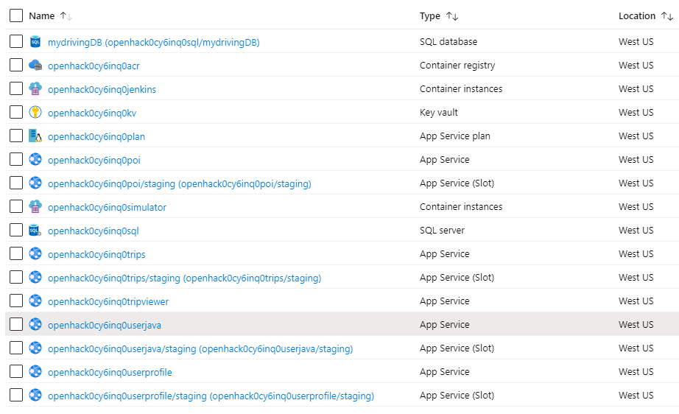
Architecture – Azure Services
Azure App Service
Standard S1
Azure Web Apps for Containers
Azure Key Vault
Standard
Azure SQL Database
S3: 100 DTUs
Azure Container Instances
1 core/1.5 GiB memory
Azure Container Registry
Basic

Slide 15
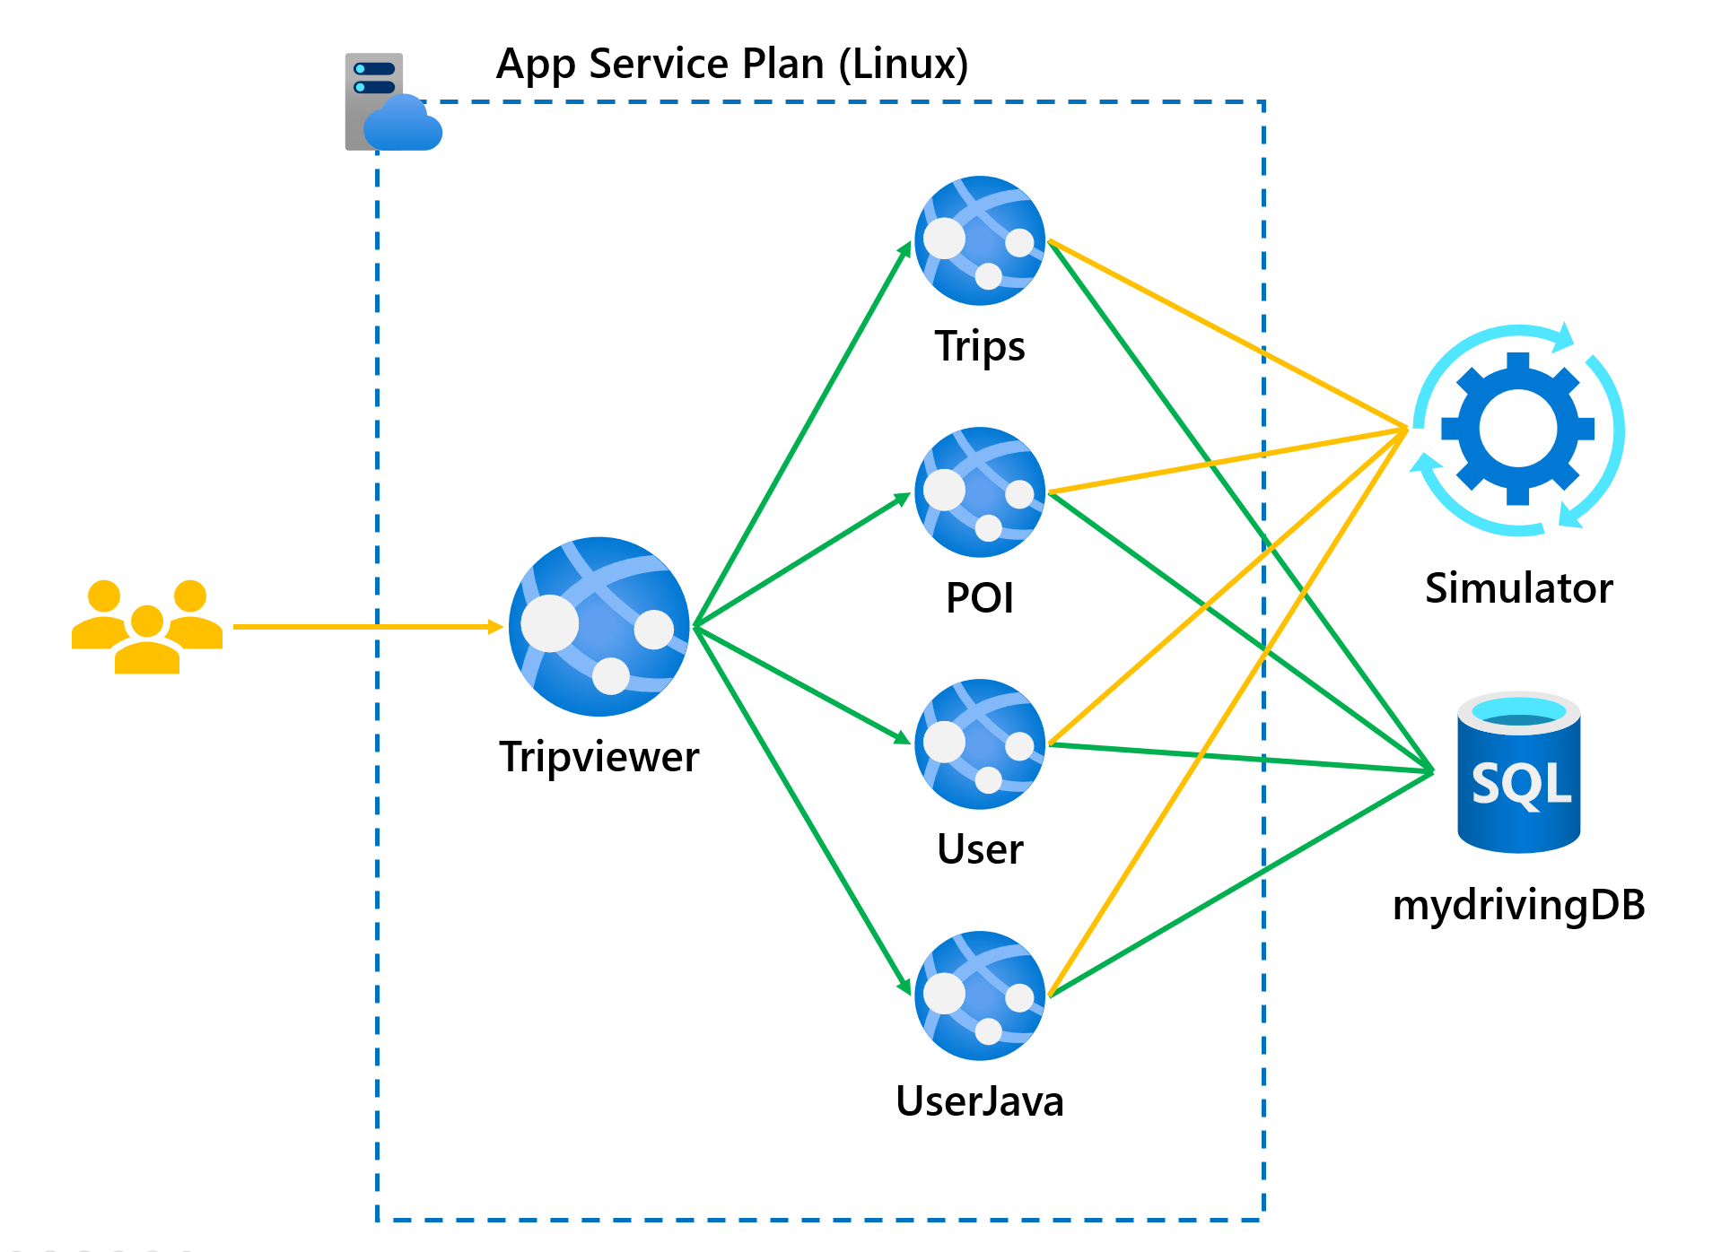
Architecture – Application and Application APIs
5 Azure Web Apps for Containers each with a staging deployment slot running the following applications
Tripviewer - the team website that your customers are using to review their driving scores and trips which are being simulated against the APIs.
Trips - the trips API is where the mobile application sends the trip data from the OBD device to be stored.
POI - the POI (Point Of Interests) API is collecting the points of the trip when a hard stop or hard acceleration was detected.
User – the user profile API is used by the application to read the user's information.
User-Java - the user (Java) API is used by the application to create and modify the users.

Slide 16
Architecture – Application Extras
Azure Key Vault – stores configuration secrets for each web application
Each API web application uses managed identities to access the Key Vault
All API web applications (production and staging) access a single instance of the mydrivingDB

Slide 17
Challenge timings
Challenge | Day | Average time (hours) | Maximum time (hours)
1 - Establish your plan | 1 | 3 | 3.5
2 - Setting up development workflow | 1 | 3.75 | 4.75
3 - Implement continuous testing | 1, 2 | 2.25 | 3.25
4 - Implement continuous deployment (CD) | 2 | 3.25 | 4.25
5 - Implement a Blue/Green deployment strategy | 2, 3 | 6 | 6
6 - Implement a monitoring solution for your MyDriving APIs | 3 | 2.5 | 4
7 - Integrating quality and security gates | 3 | TBD | TBD
8 - Implement phased rollout with rollback | 3 | TBD | TBD

Slide 18
Challenge timing guidance
You need to "watch the clock" for your table
Do not pressure your table to move faster if they are behind
Engage your lead coach(es) to discuss strategies for providing additional guidance to your table
Ask them if they have read the links in the Reference section of the challenge
Keep your table on task
For each challenge, encourage them to plan as a team and discuss their plan with your before implementation
After Challenge 1, attendees will always be implementing a solution
You are encouraged to engage your table and make sure they know to check with you prior to implementation in each Challenge

Slide 19
For each challenge
Introduce the Challenge and provide your expectations for the table
You may change requirements to accelerate or slow down your table
Encourage your team to plan and verify their plan with you
Reinforce Reference links available for the Challenge
Verify the plan for the Challenge with your table and have them proceed
After your table completes the Challenge, review the Success criteria with them
Remember, you may have changed the criteria when the Challenge started!
As a part of the Challenge retro, make sure you are calling out edge cases and / or differences in how the table solved the Challenge versus how the work would be performed at a customer site or in their own environment
This is a critical step! Do not let your table take away bad habits!

Slide 20
Environment stability
There are several actions attendees can take which will require real-time debugging, or quite often the provisioning of a new environment
If a new environment is not available (e.g. extras were not provisioned as a part of the OpenHack classroom setup), this can impact attendee progress by up to an hour
Known actions to avoid
Deleting existing Azure resources
Deleting or overwriting existing application configuration
Deleting or overwriting existing container images with the "changeme" or "latest" tag

Slide 21
Challenge 0
Set the tone

Slide 22
Challenge 0 MVP
While there is no official Challenge 0 in the attendee guide, there are some things you can do to ensure you'll have a successful and productive hack
Have attendees not only read the overview, but also
Login to their Azure subscription and explore the resources that are deployed
Attendees should be very aware that they are working with a "production" environment before they get hands on keyboard
Encourage attendees – if they can figure out how to do it on the command line, running it in Azure DevOps, GitHub, etc. is much easier once you know the command!

Slide 23
Challenge 1
Establish your plan

Slide 24
Challenge 1 MVP
This challenge is all about planning and initial configuration of their DevOps tool of choice
Attendees should be targeting people, process, and technology
People
What roles will attendees take on?
What skillsets are at the table?
Process
How are they going to communicate?
How are they going to come to consensus on tooling?
Technology
This is a Microsoft OpenHack - while there are a number of DevOps tools available, the requirements should be driving them towards GitHub and/or Azure DevOps.
You may need to reset expectations and guide attendees into the "right" solution set so they will be successful in later challenges!

Slide 25
Challenge 1 MVP – DevOps Tool Selection and Configuration
GitHub
Create a new repo. Avoid forking the azure-samples/openhack-devops-team repo.
Under repo settings be sure to enable Issues and Projects.
Add teammates as contributors to repo in Settings -> Manage Access.
Azure DevOps
Create one Azure DevOps organization per team
Invite the other hackers to the organization / project

Slide 26
Challenge 1 MVP
Kanban implemented
Personalize their account
The team should implement a Kanban using either Azure Boards or GitHub issues
Have a backlog with all the work items to be prioritized
Use the Kanban for tracking their work during the OpenHack
Pipeline
One pipeline for each API
The team shall define sub-groups that will focus in parallel on each API
How to handle when one workstream gets behind

Slide 27
Challenge 1 Success Criteria
Present the workflow and initial organization of the team
Responses to the following questions
What aspects of DevOps are you implementing?
How are you splitting the work amongst the team?
How do you keep track of your work in progress?
How will you communicate amongst the team (Verbal, Teams, Slack, HipChat, Skype, etc.)?

Slide 28
Challenge 1 Responses
Present the workflow and initial organization of the team
Everybody in the team shall be engaged, if you see anyone left aside you should facilitate the integration
The teams must refer to a work item tracking in their pipeline and they should mention somehow how it connects to the business requirements

Slide 29
Challenge 1 Responses
How will you communicate amongst the team (Verbal, Teams, Slack, HipChat, Skype, etc.)?
If your team wants to use Microsoft Teams, you will need to create a team, add invite the @skillmeup.com accounts into that team
If your team chooses an app like Teams or Slack you can suggest the plugins for Azure DevOps
Microsoft Teams Integration
Slack VSTS-Bot
A nice free tool for doing retrospectives is FunRetro

Slide 30
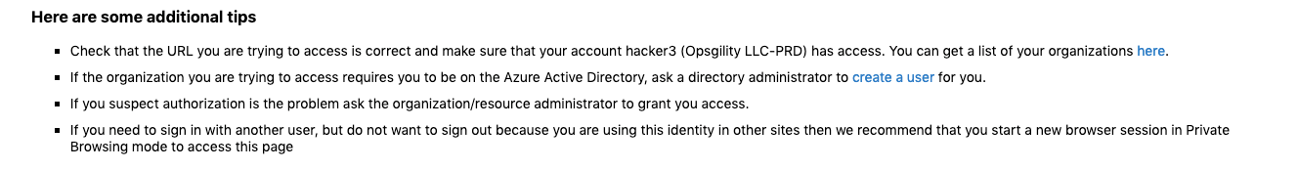
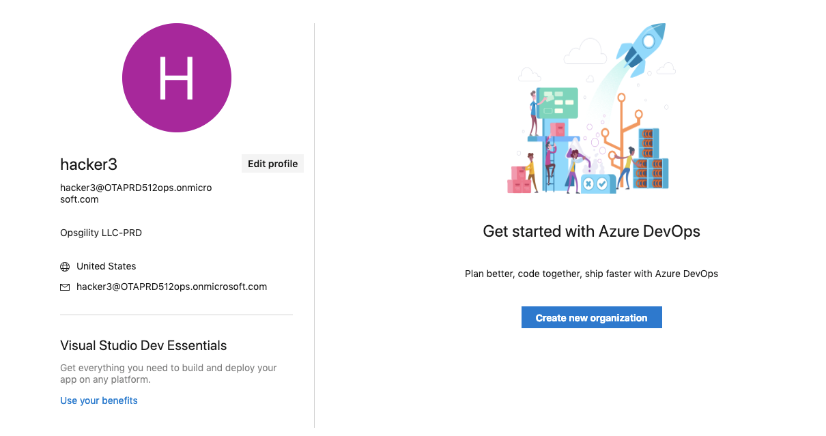
Challenge 1 Known Issues
Error 401 when connecting to Azure DevOps
Workaround: Create a new AzureDevOps organization
Click on the link "You can get your organizations here"
In the pop-up window, click "Create new organization"

Slide 31
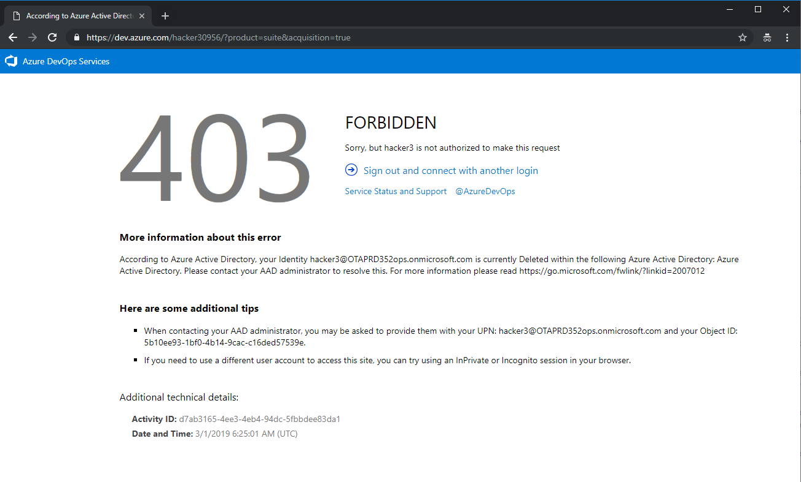
Challenge 1 Known Issues
Error 403 when connecting to Azure DevOps
When logging on, the attendee may receive a message like the following
Workaround: Close all browser windows and start a new in private mode session

Slide 32
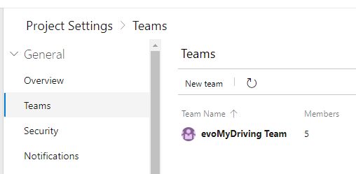
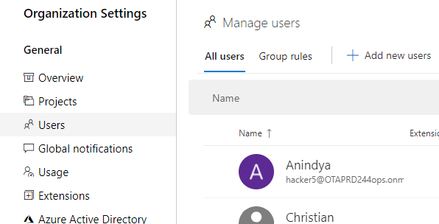
Challenge 1 Known Issues
Users invited to an organization may not be able to login
Some users may not be added to the organization even if they have been invited
Workaround
Review the members of the Azure DevOps project team under “Project settings”
Review the members of the Azure DevOps organization under “Organization settings”
If the account is missing, add it again and refresh the page

Slide 33
Challenge 2
Setting up development workflow

Slide 34
Challenge 2 MVP
This challenge is about establishing a development workflow only, the build and deployment comes in later challenges
Make sure that your teams have a location for the code and that they clone the application repository to their own environment so that they can edit the code
They will have to make code changes to the application in the future challenges
GitHub: Avoid cloning Azure-Samples/openhack-devops-team. Instead, ask the team to create a new repo. See steps in notes
Notes:
Github Repo: Instead of forking a repo, it’s good to encourage your team to clone, change the repo remote and then push to a new repo. The reason for this is that a lot of teams often open a PR back to Azure-Samples. It also makes the forked list very large. Here are the steps to set up a team GH Repo:
Create a new Repo in Github.
git clone https://github.com/Azure-Samples/openhack-devops-team.git
git remote set-url origin <new repo git url>
git remote –v //verify new url
git push –u origin master

Slide 35
Challenge 2 Success Criteria
Demonstrate to your coach that you have implemented a branch protection policy to prevent any unreviewed code changes from being committed to `master` branch. The policy must require at least two reviewers including the code owner(s).
Demonstrate to your coach that you have defined code owner(s) for each of the services.
Demonstrate to your coach that you can or have linked a work item with the associated code changes and that the artifacts that have been generated.

Slide 36
Challenge 2 Responses
Demonstrate to your coach that you have defined code owner(s) for each of the services
We call an artifact strongly owned in a time period when at least 50% of its edits where contributed by a single developer (irrespective of the total number of developers modifying the artifact)
Conversely, weakly owned files have no such primary developer
Code owner
In GitHub, code owner is a formal term and after being defined are automatically defined for pull requests
Azure DevOps has no equivalent and requires manual assignment of linked issues

Slide 37
Challenge 2
Setting up development workflow – Azure DevOps

Slide 38
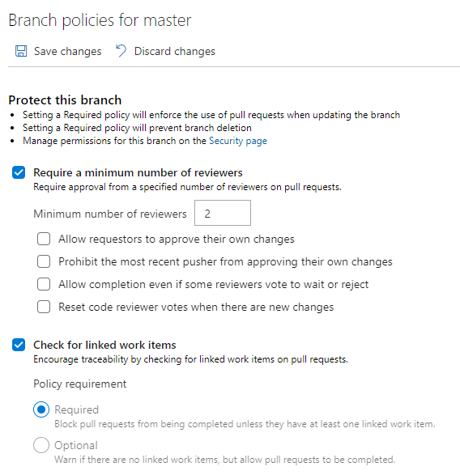
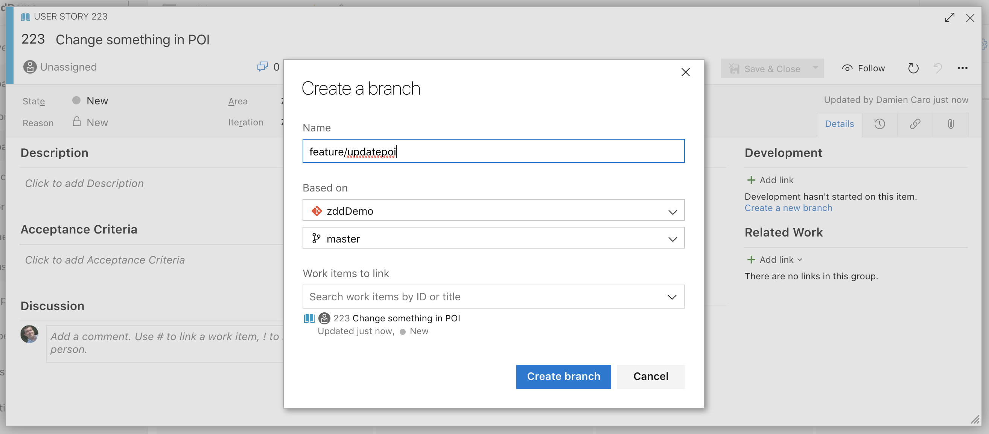
Challenge 2 MVP – Azure DevOps
Use branch policies with the following settings
Protect the master branch
Add code reviewers (at least 2 for the challenge)
Do not allow the author to approve their own changes
Check for linked work items

Slide 39
Challenge 2
Setting up development workflow – GitHub

Slide 40
Challenge 2 MVP – GitHub
Avoid Forking the Azure-Samples/openhack-devops-team repo.
Forking the repo results in many teams making pull requests back to Azure-Samples instead of their own repo. By copying, we remove this problem and it becomes a great talking point on the differences between a fork and simply pushing to a new repo.
The following repo has scripts that can help with copying: https://github.com/hattan/devops_openhack_utils/tree/master/github_repo_setup

Slide 41
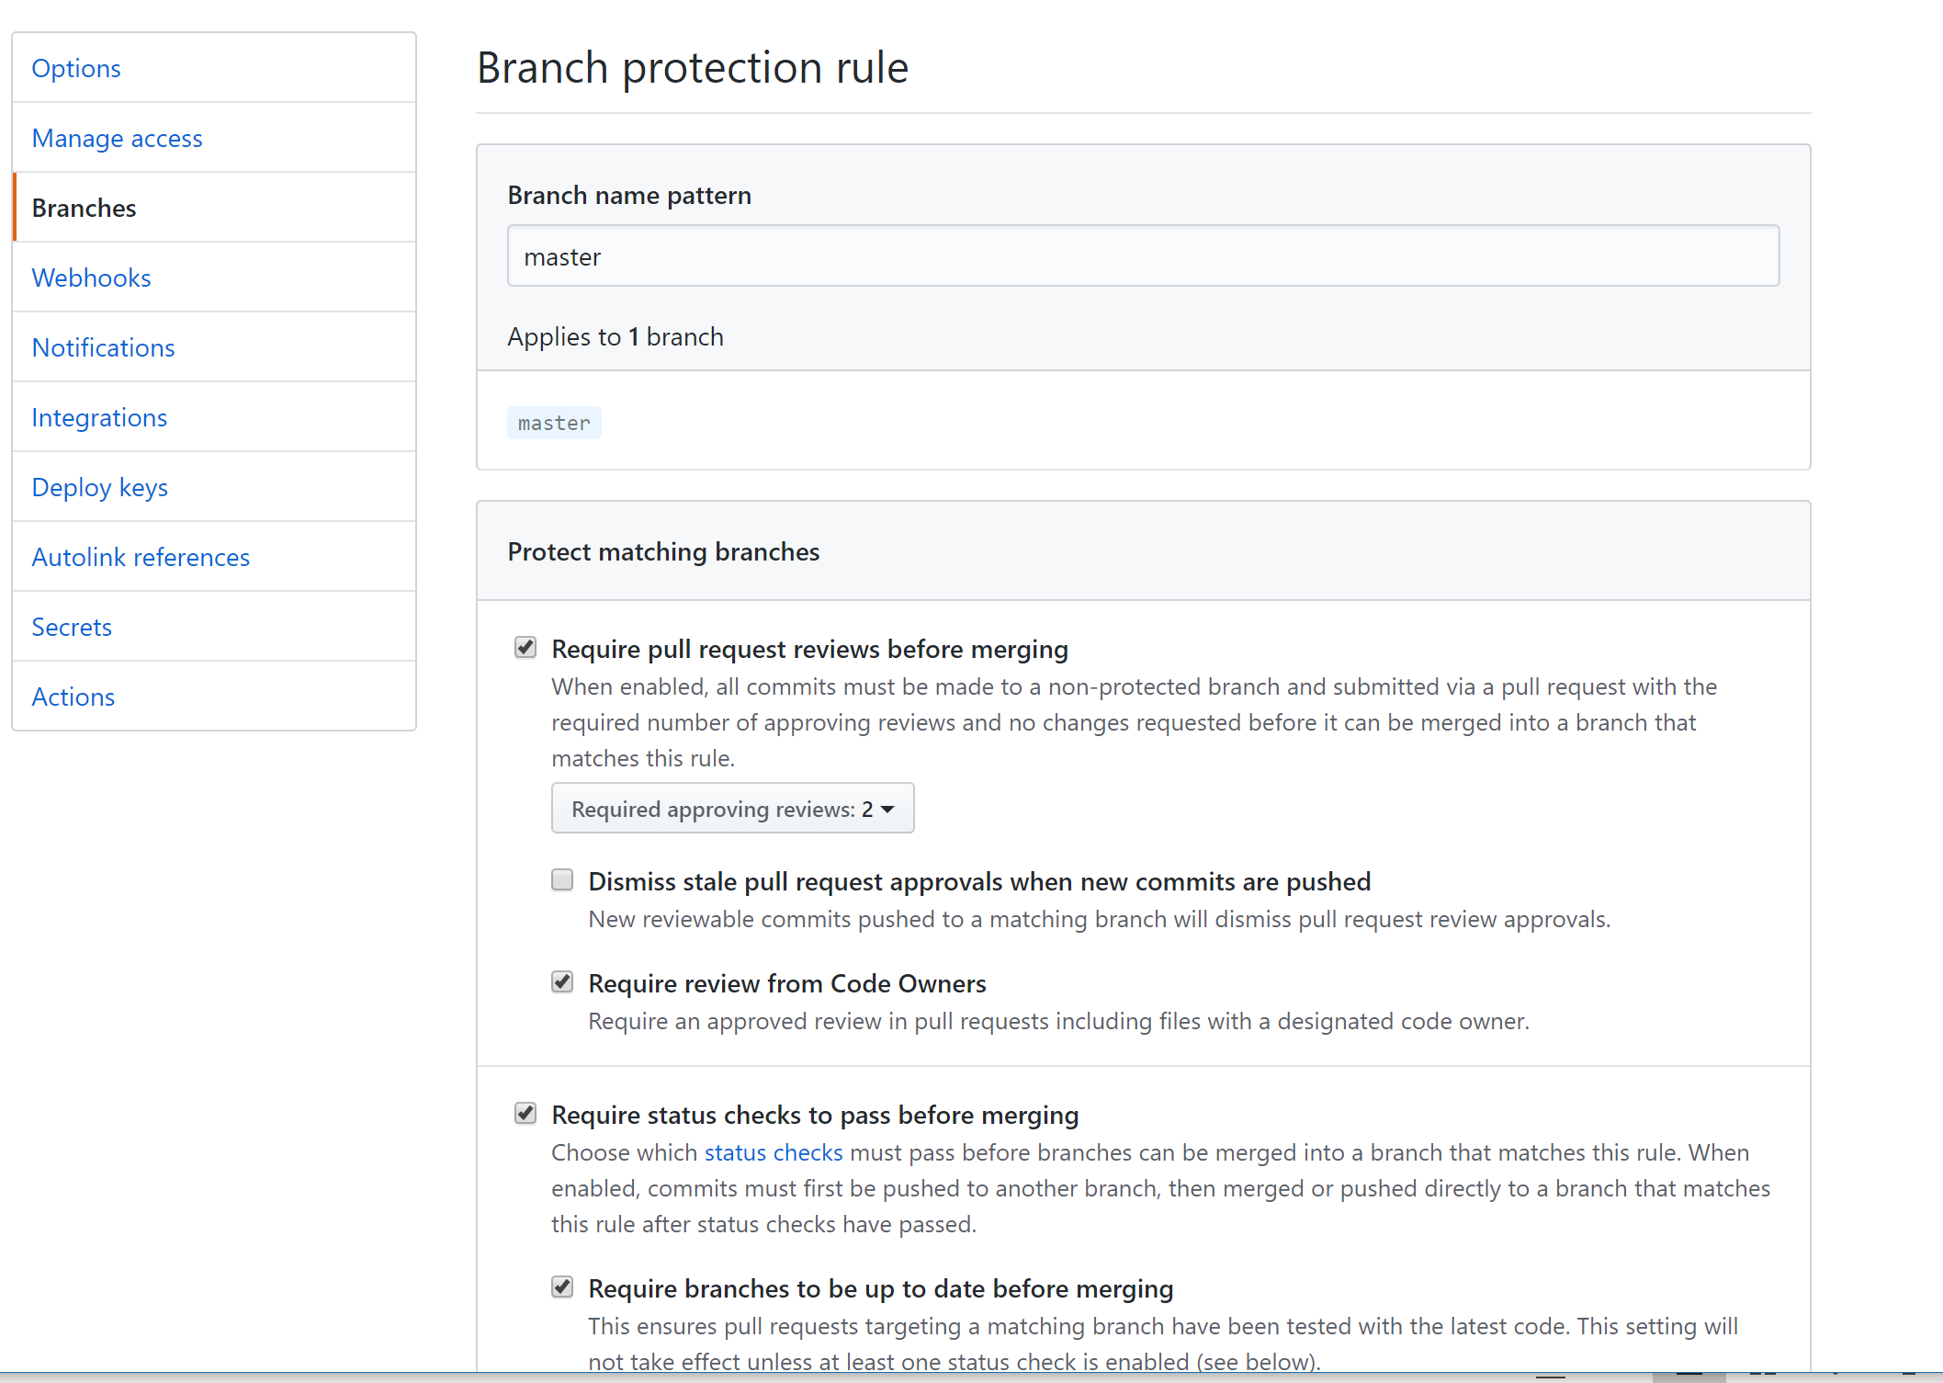
Challenge 2 MVP – GitHub
Use protected branches with the following settings
Protect the master branch
Branch name pattern = master (this is the name of the branch you want to protect.)
Require pull request reviews before merging.
Require 2 Code Reviewers.
Require Review from Code Owners
Require status checks to pass before merging
Require branches to be up to date before merging
Include administrators

Slide 42
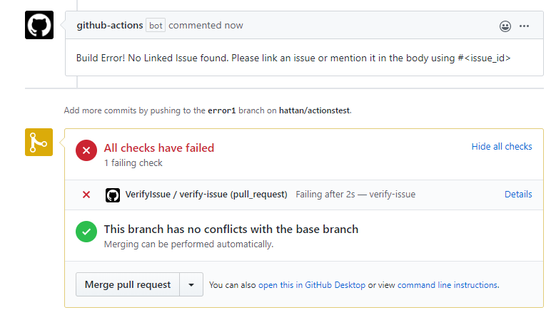
Challenge 2 MVP – GitHub
Optional: When the PR is opened check for a linked Issue or a reference to an issue in the body of the PR.
There is no built-in way to do this on GitHub. The following repo has an example of creating a workflow that will check for a linked issue or that the body of the pull request contains a #<id> with a valid issue id. https://github.com/hattan/verify-linked-issue-action/
Notes:
https://help.github.com/en/github/managing-your-work-on-github/linking-a-pull-request-to-an-issue

Slide 43
Challenge 3
Implement continuous testing

Slide 44
Challenge 3 MVP
This challenge is about Continuous Integration only, the deployment part is in Challenge 4 and Challenge 5
Azure DevOps is moving towards YAML based pipelines as the default pipeline experience
YAML can be a little daunting at first so encourage teams to try the visual designer and then view the generated YAML
They can transition to YAML based editing once they are comfortable
A sample unit test is provided for each API, although the team may want to write an additional one, but they do not have to
It is not required
To create a pipeline for each API; however it can be more enriching if attendees have the skills to do it and configure four new pipelines (one per API)
Explain the benefits of multiple pipelines and chaining/trigger pipelines (e.g. the Unit Testing pipeline can potentially trigger a build pipeline on its successful completion)

Slide 45
Challenge 3 Success Criteria
With your coach present, execute the automation workflow and explain each step
Demonstrate that the workflow is triggered for an API, only when changes are made to code for that API
Demonstrate that the workflow(s) augment existing branch protections, by performing verifications before a Pull Request (PR) can be merged to your protected branch
Demonstrate that your pipeline runs, performs all of the requisite steps and then ultimately prevents the merging of the code when the workflow fails

Slide 46
Challenge 3 Responses
Your coach will give you a breaking change to submit through your pipeline
POI – an existing branch (BREAKIN_THE_BUILD) exists on the source repository which contains a breaking change already
Trips – in apis/trips/tests/healthroute_test.go change the HTTP status code on line 16 to 204 in a feature branch and run the pipeline
User-Java – in apis/user-java/src/test/java/UserApiControllerTest.java change line 58 to profile.setId("3");
UserProfile – in apis/userprofile/tests/healthcheck/user.js change the operation on line 37 to head in a feature branch and run the pipeline

Slide 47
Challenge 3
Implement continuous testing – Azure DevOps

Slide 48
Challenge 3 MVP – Azure DevOps
It is recommended that attendees clone the repo in their project environment and use it as their main code repository
In Azure DevOps build pipelines, the feature to associate work item is on by default
Ensure that each API has a separate build mechanism so a code change shall trigger the build only for that API
Azure DevOps allows you to run multiple builds in parallel for open source projects
Make the attendees aware of this
It is strongly recommended that the attendees build their pipeline using the visual designer to create a pipeline without YAML at first
They can then export the YAML to see how it can be created using that method in the future

Slide 49
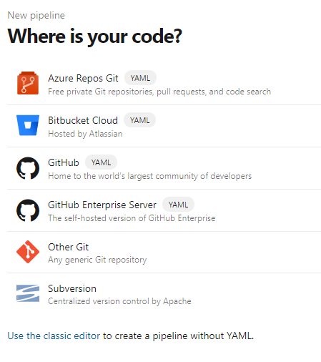
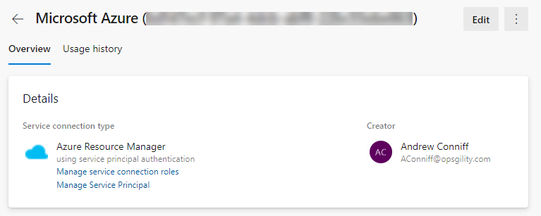
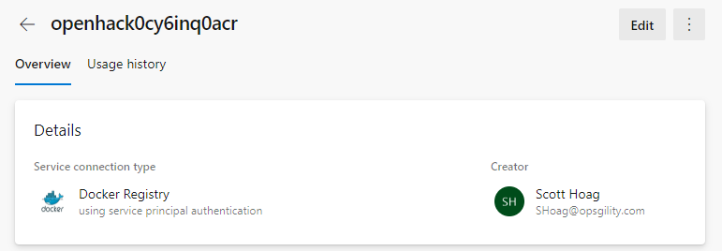
Challenge 3 MVP – Azure DevOps
To build a classic pipeline, click the "Use the classic editor" link on the New pipeline creation screen
Encourage attendees to create and reuse service connections across pipelines

Slide 50
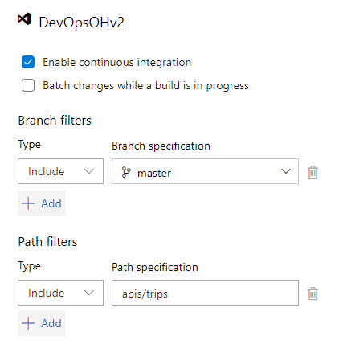
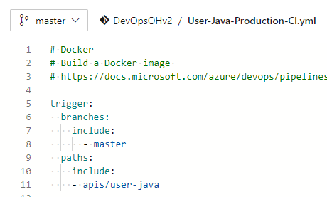
Challenge 3 MVP – Azure DevOps
Leverage triggers within your pipelines to control builds per API

Slide 51
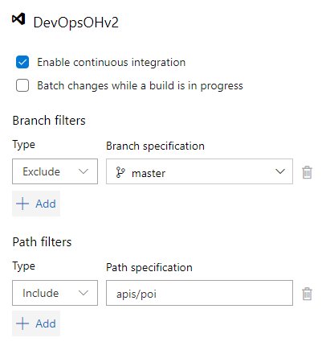
Challenge 3 MVP – Azure DevOps
Add unit testing in your workflow
The unit tests already exist in the repo!
Each language has a different implementation of unit testing
Viewing the existing Dockerfile for each API is a great hint execute of how to locate and build the code the unit tests run against
Use the result of the unit test as a gate for merging changes
Attendees should create a new pipeline to run the unit tests
Run only on commits that are on feature branches (requires triggers to evaluate branches other than master)

Slide 52
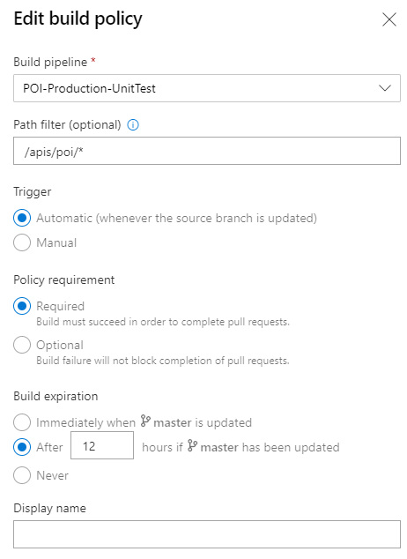
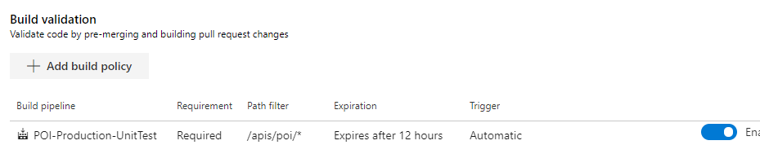
Challenge 3 MVP – Azure DevOps
Build policies can be implemented on the master branch to provide additional protection
Unit testing pipeline(s) need to be added to the policy
Required to pass
Include a path filter for the target API

Slide 53
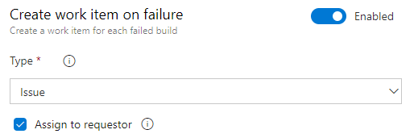
Challenge 3 Responses – Azure DevOps
When the test does not complete successfully, show that an issue has been created in the team's backlog
Update the pipeline and configure Create a work item on failure
This feature is not natively available in YAML pipelines but there are tasks available in the Marketplace such as Create Work Item

Slide 54
Challenge 3 MVP – Azure DevOps – Testing Documentation
POI
Build, test, and deploy .NET Core apps
Trips
Build and test Go projects
User-Java
Build Java apps
UserProfile
Build, test, and deploy JavaScript and Node.js apps

Slide 55
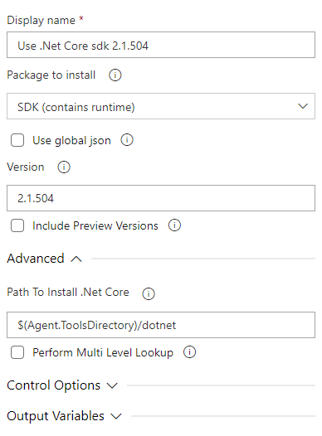
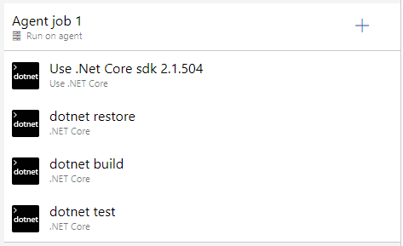
Challenge 3 MVP – Azure DevOps – POI Classic Editor

Slide 56
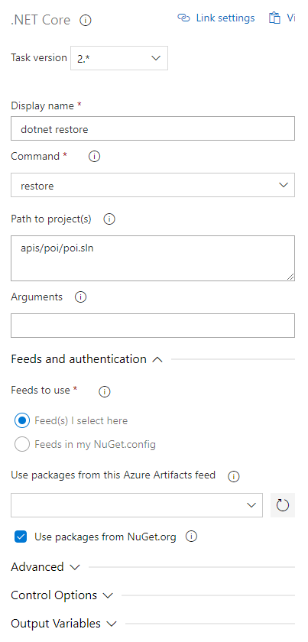
Challenge 3 MVP – Azure DevOps – POI Classic Editor

Slide 57
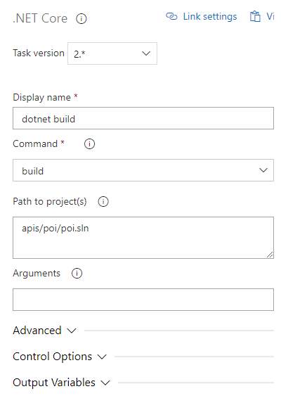
Challenge 3 MVP – Azure DevOps – POI Classic Editor

Slide 58
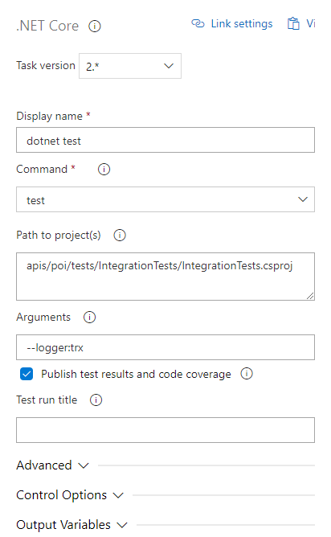
Challenge 3 MVP – Azure DevOps – POI Classic Editor

Slide 59
Challenge 3 MVP – Azure DevOps – POI YAML
# Run POI Unit Tests
trigger:
branches:
include:
- '*'
exclude:
- master
paths:
include:
- apis/poi/*
pool:
vmImage: 'ubuntu-latest'
stages:
- stage: rununittest
displayName: Run unit tests
jobs:
- job: rununittest
displayName: Run unit tests
pool:
vmImage: 'ubuntu-latest'
steps:
- task: UseDotNet@2
displayName: dotnet install
inputs:
packageType: 'sdk'
version: '2.1.504'
- task: DotNetCoreCLI@2
displayName: dotnet restore
inputs:
command: 'restore'
projects: 'apis/poi/poi.sln'
feedsToUse: 'select'
- task: DotNetCoreCLI@2
displayName: dotnet build
inputs:
command: 'build'
projects: 'apis/poi/poi.sln'
- task: DotNetCoreCLI@2
displayName: dotnet test
inputs:
command: 'test'
projects: 'apis/poi/tests/IntegrationTests/IntegrationTests.csproj'
arguments: '--logger:trx'
- job: createworkitem
displayName: Create work item on failure
dependsOn: rununittest
condition: failed() # this job will only run if rununittest fails
steps:
- task: CreateWorkItem@1
displayName: Create work item on failure
inputs:
workItemType: 'Issue'
title: 'Build $(Build.BuildId) failed'

Slide 60
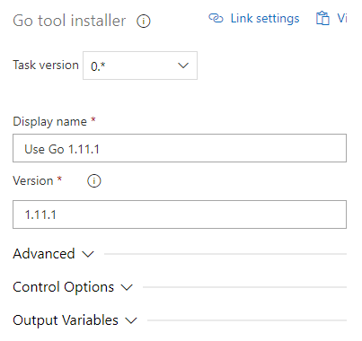
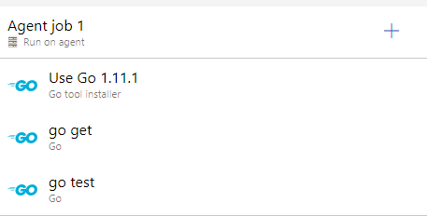
Challenge 3 MVP – Azure DevOps – Trips Classic Editor

Slide 61
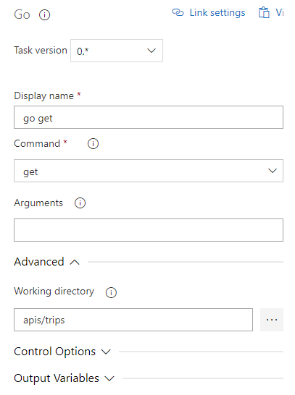
Challenge 3 MVP – Azure DevOps – Trips Classic Editor

Slide 62
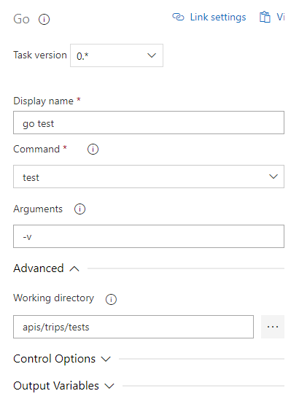
Challenge 3 MVP – Azure DevOps – Trips Classic Editor

Slide 63
Challenge 3 MVP – Azure DevOps – Trips YAML
# Run Trips Unit Tests
trigger:
branches:
include:
- '*'
exclude:
- master
paths:
include:
- apis/trips/*
pool:
vmImage: 'ubuntu-latest'
stages:
- stage: rununittest
displayName: Run unit tests
jobs:
- job: rununittest
displayName: Run unit tests
pool:
vmImage: 'ubuntu-latest'
steps:
- task: GoTool@0
displayName: Use Go 1.11.1
inputs:
version: '1.11.1'
- task: Go@0
displayName: go get
inputs:
command: 'get'
workingDirectory: 'apis/trips'
- task: Go@0
displayName: go test
inputs:
command: 'test'
arguments: '-v'
workingDirectory: 'apis/trips/tests'
- job: createworkitem
displayName: Create work item on failure
dependsOn: rununittest
condition: failed() # this job will only run if rununittest fails
steps:
- task: CreateWorkItem@1
displayName: Create work item on failure
inputs:
workItemType: 'Issue'
title: 'Build $(Build.BuildId) failed'

Slide 64
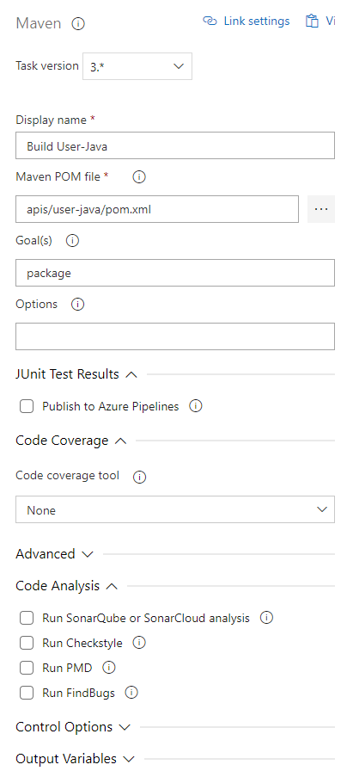
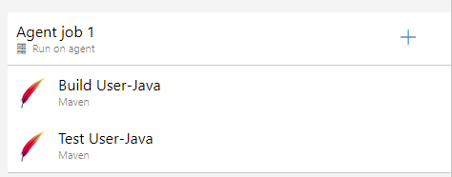
Challenge 3 MVP – Azure DevOps – User-Java Classic Editor

Slide 65
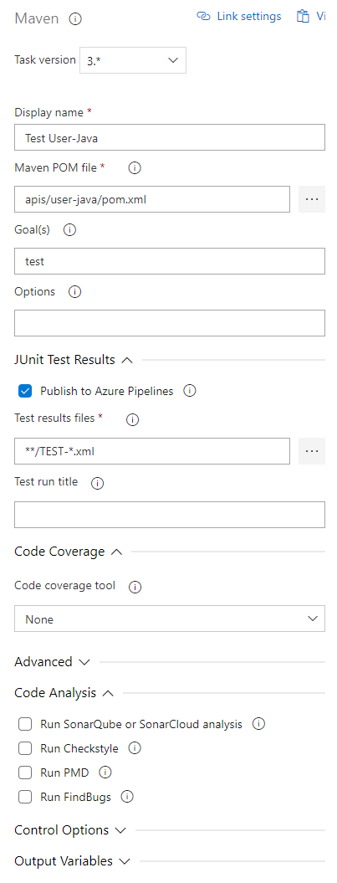
Challenge 3 MVP – Azure DevOps – User-Java Classic Editor

Slide 66
Challenge 3 MVP – Azure DevOps – User-Java YAML
# Run User-Java Unit Tests
trigger:
branches:
include:
- '*'
exclude:
- master
paths:
include:
- apis/user-java/*
pool:
vmImage: 'ubuntu-latest'
stages:
- stage: rununittest
displayName: Run unit tests
jobs:
- job: rununittest
displayName: Run unit tests
pool:
vmImage: 'ubuntu-latest'
steps:
- task: Maven@3
displayName: Build User-Java
inputs:
mavenPomFile: 'apis/user-java/pom.xml'
publishJUnitResults: false
javaHomeOption: 'JDKVersion'
mavenVersionOption: 'Default'
mavenAuthenticateFeed: false
effectivePomSkip: false
sonarQubeRunAnalysis: false
- task: Maven@3
displayName: Test User-Java
inputs:
mavenPomFile: 'apis/user-java/pom.xml'
goals: 'test'
publishJUnitResults: true
testResultsFiles: '**/TEST-*.xml'
javaHomeOption: 'JDKVersion'
mavenVersionOption: 'Default'
mavenAuthenticateFeed: false
effectivePomSkip: false
sonarQubeRunAnalysis: false
- job: createworkitem
displayName: Create work item on failure
dependsOn: rununittest
condition: failed() # this job will only run if rununittest fails
steps:
- task: CreateWorkItem@1
displayName: Create work item on failure
inputs:
workItemType: 'Issue'
title: 'Build $(Build.BuildId) failed'

Slide 67
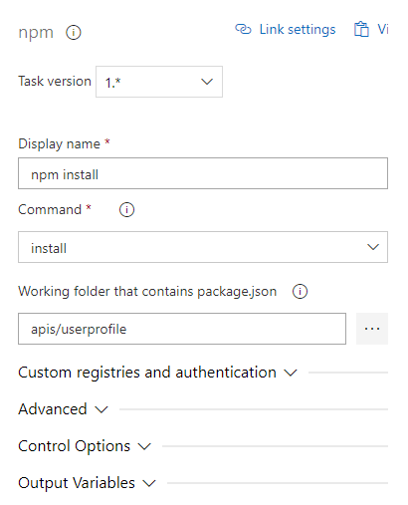
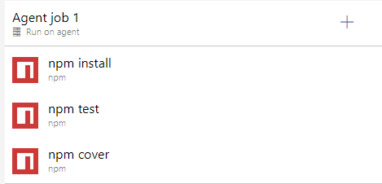
Challenge 3 MVP – Azure DevOps – UserProfile Classic Editor

Slide 68
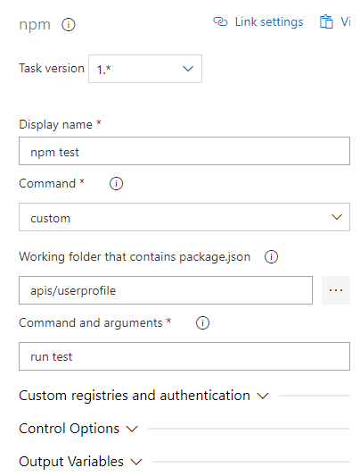
Challenge 3 MVP – Azure DevOps – UserProfile Classic Editor

Slide 69
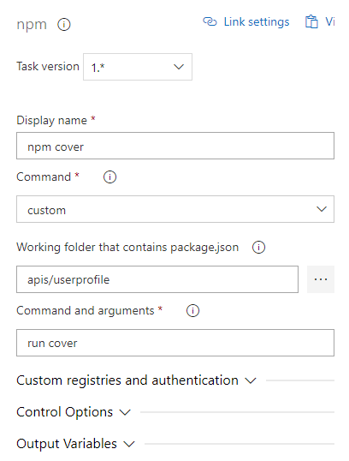
Challenge 3 MVP – Azure DevOps – UserProfile Classic Editor

Slide 70
Challenge 3 MVP – Azure DevOps – UserProfile YAML
# Run UserProfile Unit Tests
trigger:
branches:
include:
- '*'
exclude:
- master
paths:
include:
- apis/userprofile/*
pool:
vmImage: 'ubuntu-latest'
stages:
- stage: rununittest
displayName: Run unit tests
jobs:
- job: rununittest
displayName: Run unit tests
pool:
vmImage: 'ubuntu-latest'
steps:
- task: Npm@1
displayName: npm install
inputs:
command: 'install'
workingDir: 'apis/userprofile'
- task: Npm@1
displayName: npm test
inputs:
command: 'custom'
workingDir: 'apis/userprofile'
customCommand: 'run test'
- task: Npm@1
displayName: npm cover
inputs:
command: 'custom'
workingDir: 'apis/userprofile'
customCommand: 'run cover'
- job: createworkitem
displayName: Create work item on failure
dependsOn: rununittest
condition: failed() # this job will only run if rununittest fails
steps:
- task: CreateWorkItem@1
displayName: Create work item on failure
inputs:
workItemType: 'Issue'
title: 'Build $(Build.BuildId) failed'

Slide 71
Challenge 3
Implement continuous testing – GitHub

Slide 72
Challenge 3 MVP – GitHub - POI
Ensure that the actions/setup-dotnet action does not reference .net core 3.1.101 (which is what the starter template points to.) If you leave it at 3.1.101, the .net build will work but in a subsequent challenge, docker builds will fail. You can either:
Set it to 3.1.202
Remove the “with: dotnet-version” property entirely. Removing the property will default to latest and will work.
- name: Setup .NET Core
uses: actions/setup-dotnet@v1
with:
dotnet-version: '3.1.202'

Slide 73
Challenge 3 MVP – GitHub – POI
name: POI CICD
env:
poi_path: apis/poi/**
registry: docker.pkg.github.com
repository: hattan/openhack-devops-team-gh/api-poi
docker_path: apis/poi/web
staging_url: https://openhackxv61mxh2poi-staging.azurewebsites.net
prod_url: https://openhackxv61mxh2poi.azurewebsites.net
resource_group: openhackxv61mxh2rg
webapp_name: openhackxv61mxh2poi
build_name: POI
on:
push:
branches: [ master ]
paths:
- apis/poi/**
- .github/workflows/poi.yml
pull_request:
branches: [ master ]
paths:
- apis/poi/**
- .github/workflows/poi.yml
jobs:
build_and_test:
runs-on: ubuntu-latest
steps:
- uses: actions/checkout@v2
- name: Setup .NET Core
uses: actions/setup-dotnet@v1
with:
dotnet-version: '3.1.202'
- name: Add Code Coverage Tools
working-directory: apis/poi/tests/UnitTests
run: dotnet add package coverlet.msbuild
- name: Install dependencies
run: dotnet restore apis/poi/web/*.csproj
- name: .NET Build Web
run: dotnet build --configuration Release --no-restore apis/poi/web/*.csproj
- name: .NET Build Unit Tests
run: dotnet build --configuration Release apis/poi/tests/UnitTests/UnitTests.csproj
- name: .NET Test
run: dotnet test --no-restore --verbosity normal apis/poi/tests/UnitTests /p:CollectCoverage=true /p:CoverletOutput=lcov/ /p:CoverletOutputFormat=lcov
- name: Coveralls
uses: coverallsapp/github-action@master
with:
github-token: ${{ secrets.GITHUB_TOKEN }}
path-to-lcov: apis/poi/tests/UnitTests/lcov/coverage.info
base-path: apis/poi
flag-name: Unit

Slide 74
Challenge 3 MVP – GitHub – Trips
name: Trips CICD
env:
registry: docker.pkg.github.com
repository: hattan/openhack-devops-team-gh/api-trips
docker_path: apis/trips
staging_url: https://openhackxv61mxh2trips-staging.azurewebsites.net/
prod_url: https://openhackxv61mxh2trips.azurewebsites.net/
resource_group: openhackxv61mxh2rg
webapp_name: openhackxv61mxh2trips
build_name: Trips
webv_path: apis/trips/webvalidate
on:
push:
branches: [ master ]
paths:
- apis/trips/**
- .github/workflows/trips.yml
pull_request:
branches: [ master ]
paths:
- apis/trips/**
- .github/workflows/trips.yml
jobs:
build_and_test:
runs-on: ubuntu-latest
defaults:
run:
shell: bash
working-directory: apis/trips
steps:
- uses: actions/checkout@v2
- name: Setup Go environment
uses: actions/setup-go@v2.0.3
with:
go-version: 1.12
- name: Install dependencies
run: go get
- name: Run Unit Tests
run: go test ./tests
- uses: actions/github-script@0.9.0
if: failure()
with:
github-token: ${{secrets.GITHUB_TOKEN}}
script: |
let body = "${{ env.build_name }} Worflow Failure \n Build Number: ${{ github.run_number }} \n Build Log: https://github.com/${{ github.repository }}/actions/runs/${{ github.run_id }} \n SHA: [${{ github.sha }}](https://github.com/${{ github.repository }}/commit/${{ github.sha }}) \n";
github.issues.create({
owner: context.repo.owner,
repo: context.repo.repo,
title: "${{ env.build_name }} Workflow ${{ github.run_number }} Failed! ",
body: body
});

Slide 75
Challenge 3 MVP – GitHub – User Java
name: User Java CICD
env:
registry: docker.pkg.github.com
repository: hattan/openhack-devops-team-gh/api-user-java
docker_path: apis/user-java
staging_url: https://openhackxv61mxh2userjava-staging.azurewebsites.net/
prod_url: https://openhackxv61mxh2userjava.azurewebsites.net/
resource_group: openhackxv61mxh2rg
webapp_name: openhackxv61mxh2userjava
build_name: User Java
webv_path: apis/user-java/webvalidate
on:
push:
branches: [ master ]
paths:
- apis/user-java/**
- .github/workflows/user-java.yml
pull_request:
branches: [ master ]
paths:
- apis/user-java/**
- .github/workflows/user-java.yml
jobs:
build_and_test:
runs-on: ubuntu-latest
defaults:
run:
shell: bash
working-directory: apis/user-java
steps:
- uses: actions/checkout@v2
- name: Set up JDK 11
uses: actions/setup-java@v1
with:
java-version: 11
- name: Run Unit Tests
run: mvn test
- uses: actions/github-script@0.9.0
if: failure()
with:
github-token: ${{secrets.GITHUB_TOKEN}}
script: |
let body = "${{ env.build_name }} Worflow Failure \n Build Number: ${{ github.run_number }} \n Build Log: https://github.com/${{ github.repository }}/actions/runs/${{ github.run_id }} \n SHA: [${{ github.sha }}](https://github.com/${{ github.repository }}/commit/${{ github.sha }}) \n";
github.issues.create({
owner: context.repo.owner,
repo: context.repo.repo,
title: "${{ env.build_name }} Workflow ${{ github.run_number }} Failed! ",
body: body
});

Slide 76
Challenge 3 MVP – GitHub – User Profile
name: User Profile CICD
env:
registry: docker.pkg.github.com
repository: hattan/openhack-devops-team-gh/api-user
docker_path: apis/userprofile
staging_url: https://openhackxv61mxh2userprofile-staging.azurewebsites.net/
prod_url: https://openhackxv61mxh2userprofile.azurewebsites.net/
resource_group: openhackxv61mxh2rg
webapp_name: openhackxv61mxh2userprofile
build_name: User Profile
webv_path: apis/userprofile/webvalidate
on:
push:
branches: [ master ]
paths:
- apis/userprofile/**
- .github/workflows/userprofile.yml
pull_request:
branches: [ master ]
paths:
- apis/userprofile/**
- .github/workflows/userprofile.yml
jobs:
build_and_test:
runs-on: ubuntu-latest
defaults:
run:
shell: bash
working-directory: apis/userprofile
steps:
- uses: actions/checkout@v2
- name: Use Node.js 10.x
uses: actions/setup-node@v1
with:
node-version: 10.x
- run: npm ci
- run: npm run build --if-present
- run: npm run test
- uses: actions/github-script@0.9.0
if: failure()
with:
github-token: ${{secrets.GITHUB_TOKEN}}
script: |
let body = "${{ env.build_name }} Worflow Failure \n Build Number: ${{ github.run_number }} \n Build Log: https://github.com/${{ github.repository }}/actions/runs/${{ github.run_id }} \n SHA: [${{ github.sha }}](https://github.com/${{ github.repository }}/commit/${{ github.sha }}) \n";
github.issues.create({
owner: context.repo.owner,
repo: context.repo.repo,
title: "${{ env.build_name }} Workflow ${{ github.run_number }} Failed! ",
body: body
});

Slide 77
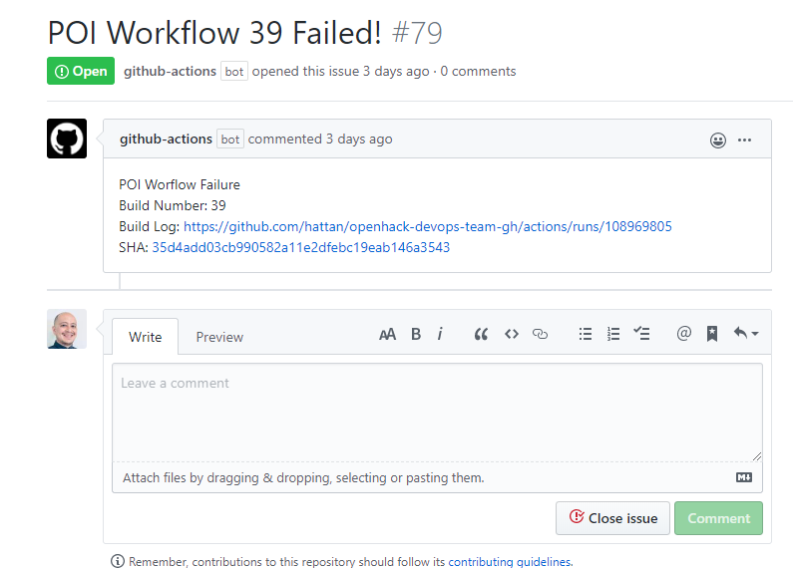
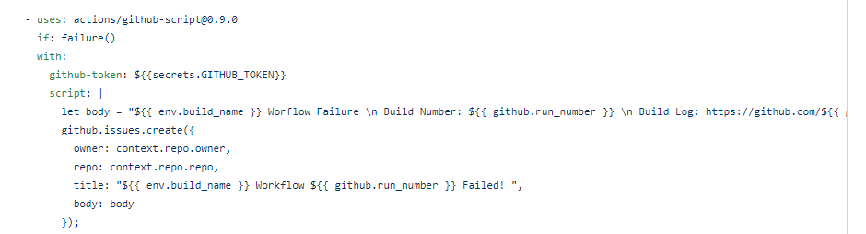
Challenge 3 Responses – GitHub
Optional: When the test does not complete successfully, show that an issue has been created in the team's backlog. This is an optional goal when using GitHub Actions. There is no built-in way to do this on GitHub. You can use GitHub-Script to do this with a custom script action like so:
https://gist.github.com/hattan/3760f239330a76cf5b47157da8c54dfe

Slide 78
Challenge 4
Implement continuous deployment (CD)

Slide 79
Challenge 4 MVP
On a successful build, demonstrate that the updated version of the container image is pushed to the existing Azure Container Registry or to GitHub Packages
Note: Your build process should not overwrite the existing image with the changeme tag when using ACR
The team needs to show you that they can deploy the APIs correctly to each Azure Web App
It is acceptable if they introduce downtime at this point
But they should not have to – they can leverage the existing staging deployment slots for each API
Extra credit is recognizing and targeting the staging slots to prevent downtime in production!
You can introduce a change in the message of the health status response for one of the APIs and verify that it has been correctly deployed
Generically, teams can use
The Azure CLI or Azure PowerShell to deploy the updated container to a web app

Slide 80
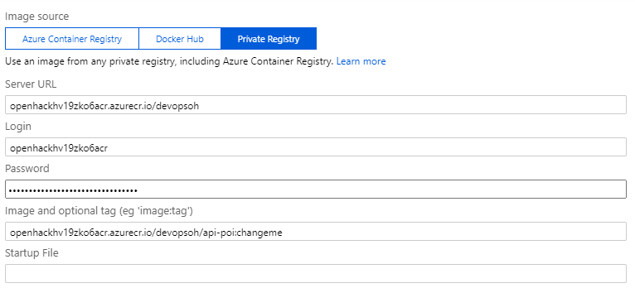
Challenge 4 MVP
To rollback a web app from a bad deployment, you can reset the Image and optional tag setting in the web app to point to the changeme tag
Make sure to click Save after updating

Slide 81
Challenge 4 Success Criteria
Your coach will provide you with an update to your APIs
You must demonstrate that you can reference the deployment of these API updates with the corresponding work items
Demonstrate to your coach that in your build/workflow
The container images (one per API) are published to the registry of your choice (only when building master but not on PRs)
Your publish process should not overwrite the existing image with the changeme tag, so consider how you will insure unique values for image tags.
The API(s) code is deployed to the Azure App Service every time code is pushed to master (if the code compiles and all tests pass, but only when building master branch)
Your branch/pull request policy can be used to enforce workflow and gates between CI and CD activities

Slide 82
Challenge 4
Implement continuous deployment (CD) – Azure DevOps
Notes:
sdfasdf

Slide 83
Challenge 4 MVP – Azure DevOps
Teams will be extending existing pipelines or creating new Release pipelines based on their approach
If your team is using
The GUI/classic editor, leverage Release pipelines
Deploy to an Azure Web App for Containers task
YAML pipelines, leverage Stages in existing pipelines
Azure Web App for Container task
Teams can leverage other task types as well such as the Azure CLI or Azure PowerShell tasks with inline scripts, but it is much easier to use the Azure Web Apps for Container(s) tasks

Slide 84
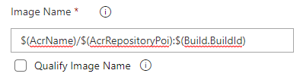
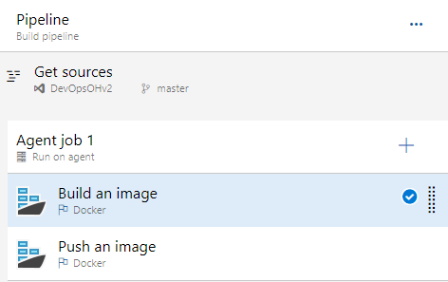
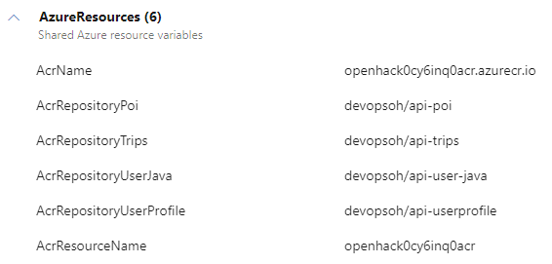
Challenge 4 MVP – Azure DevOps – Traditional Docker build
Implement one pipeline for each API with the following tasks
Build an image and tag with a unique ID that is automatically generated such as $(Build.BuildId)
Push an image to Azure Container Registry

Slide 85
Challenge 4 MVP – Azure DevOps – Traditional Docker build YAML
# Build and push a Docker image
trigger:
branches:
include:
- master
paths:
include:
- apis/user-java/*
resources:
- repo: self
variables:
- group: AzureResources
stages:
- stage: BuildAndPush
displayName: Build and push an image
jobs:
- job: BuildAndPush
displayName: Build and Push
pool:
vmImage: 'ubuntu-latest'
steps:
- task: Docker@2
displayName: Build and push an image
inputs:
containerRegistry: $(AcrResourceName)
repository: $(AcrRepositoryUserJava)
command: 'buildAndPush'
Dockerfile: '$(Build.SourcesDirectory)/apis/user-java/Dockerfile'
addPipelineData: false
tags: |
$(Build.BuildId)

Slide 86
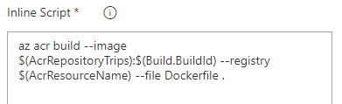
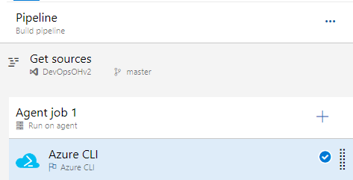
Challenge 4 MVP – Azure DevOps – ACR Build Tasks
One task alternative pipeline
Build an image and tag with a unique ID that is automatically generated such as $(Build.BuildId)
Push an image to Azure Container Registry using az acr build

Slide 87
Challenge 4 MVP – Azure DevOps – ACR Build Tasks YAML
# Build UserProfile in ACR
trigger:
branches:
include:
- master
paths:
include:
- apis/userprofile/*
resources:
- repo: self
variables:
- group: AzureResources
pool:
vmImage: 'ubuntu-latest'
stages:
- stage: ACRBuild
displayName: Build and push an image
jobs:
- job: ACRBuild
displayName: Push Dockerfile to ACR
pool:
vmImage: 'ubuntu-latest'
steps:
- task: AzureCLI@2
inputs:
azureSubscription: 'Microsoft Azure (bd147ecf-97a4-4dcb-abf8-22bc55ebe863)'
scriptType: 'bash'
scriptLocation: 'inlineScript'
inlineScript: 'az acr build --image $(AcrRepositoryUserProfile):$(Build.BuildId) --registry $(AcrResourceName) --file Dockerfile .'
workingDirectory: 'apis/userprofile'

Slide 88
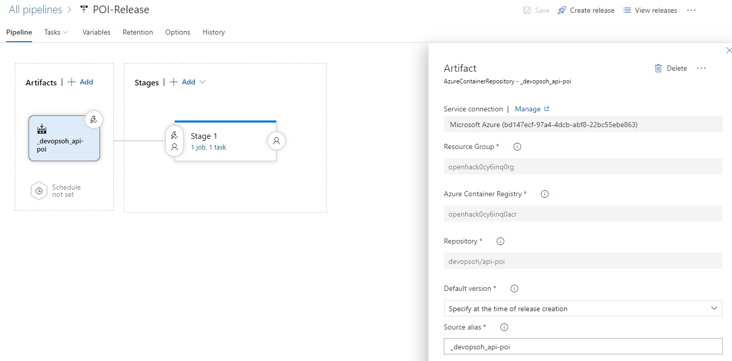
Challenge 4 MVP – Azure DevOps – Classic Release

Slide 89
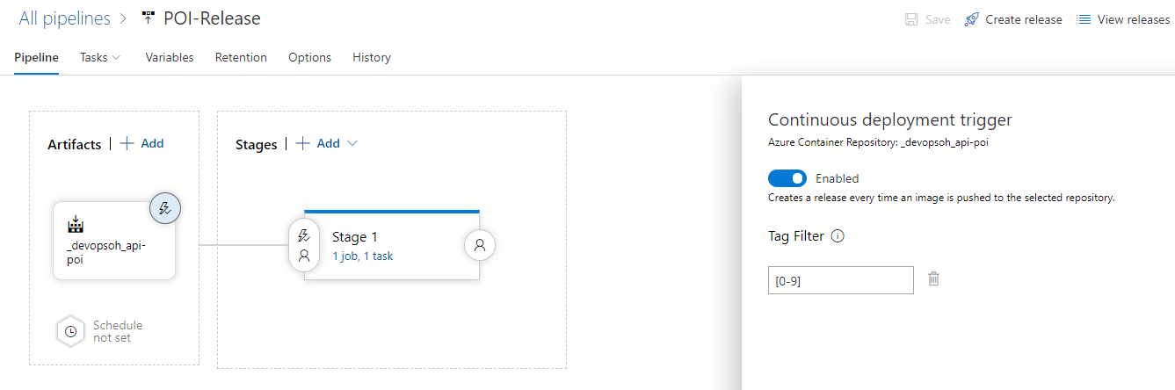
Challenge 4 MVP – Azure DevOps – Classic Release

Slide 90
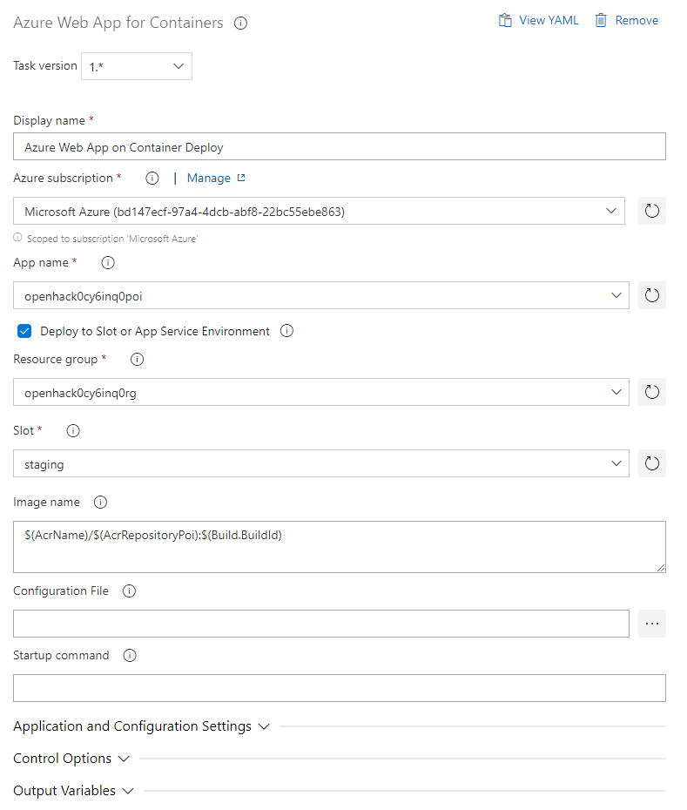

Challenge 4 MVP – Azure DevOps – Classic Release

Slide 91
Challenge 4 MVP – Azure DevOps – YAML Release (chained)
# Run POI Release
resources:
pipelines:
- pipeline: poici # Name of the pipeline resource
source: POI-Production-CI # Name of the triggering pipeline
trigger:
branches:
include:
- master
pool:
vmImage: 'ubuntu-latest'
variables:
- group: AzureResources
stages:
- stage: releasewebapptostaging
displayName: Release POI to App to Staging
jobs:
- job: releasewebapptostaging
displayName: Release POI to App to Staging
pool:
vmImage: 'ubuntu-latest'
steps:
- bash: |
# Add variable IMGTAG to all downstream steps
echo '##vso[task.setvariable variable=IMGTAG]latest'
displayName: Create IMGTAG variable
- task: AzureCLI@2
displayName: Retrieve the most current image tag
inputs:
azureSubscription: 'Microsoft Azure (bd147ecf-97a4-4dcb-abf8-22bc55ebe863)'
scriptType: 'bash'
scriptLocation: 'inlineScript'
inlineScript: |
# Set IMGTAG value to last written image tag
IMGTAG=$(az acr repository show-tags -n $(AcrResourceName) --repository $(AcrRepositoryPoi) --orderby time_desc -o tsv --query [0])
echo "##vso[task.setvariable variable=IMGTAG]${IMGTAG}"
echo "Proceeding with image tag $(AcrRepositoryPoi):$IMGTAG"
- task: AzureWebAppContainer@1
displayName: Azure Web App on Container Deploy
inputs:
azureSubscription: 'Microsoft Azure (bd147ecf-97a4-4dcb-abf8-22bc55ebe863)'
appName: 'openhack0cy6inq0poi'
deployToSlotOrASE: true
resourceGroupName: 'openhack0cy6inq0rg'
slotName: 'staging'
containers: '$(AcrName)/$(AcrRepositoryPoi):$(IMGTAG)'
- bash: |
echo "Repo with image tag: $(AcrName)/$(AcrRepositoryPoi):$(IMGTAG)"
displayName: Echo build information
- job: createworkitem
displayName: Create work item on failure
dependsOn: releasewebapptostaging
condition: failed() # this job will only run if rununittest fails
steps:
- task: CreateWorkItem@1
displayName: Create work item on failure
inputs:
workItemType: 'Issue'
title: 'Build $(Build.BuildId) failed'
Notes:
This is designed to run as a single stage pipeline trigged off a separate build pipeline

Slide 92


Challenge 4 MVP – Azure DevOps – YAML Release (chained)
All YAML pipelines run as CI pipelines by default and if running Release in a separate (chained) pipeline, you must disable CI
Trigger one pipeline after another

Slide 93
Challenge 4 MVP – Azure DevOps – YAML Release (chained)
# Run POI Release
resources:
pipelines:
- pipeline: poici # Name of the pipeline resource
source: POI-Production-CI # Name of the triggering pipeline
trigger:
branches:
include:
- master
pool:
vmImage: 'ubuntu-latest'
variables:
- group: AzureResources
stages:
- stage: releasewebapptostaging
displayName: Release POI to App to Staging
jobs:
- job: releasewebapptostaging
displayName: Release POI to App to Staging
pool:
vmImage: 'ubuntu-latest'
steps:
- bash: |
# Add variable IMGTAG to all downstream steps
echo '##vso[task.setvariable variable=IMGTAG]latest'
displayName: Create IMGTAG variable
- task: AzureCLI@2
displayName: Retrieve the most current image tag
inputs:
azureSubscription: 'Microsoft Azure (bd147ecf-97a4-4dcb-abf8-22bc55ebe863)'
scriptType: 'bash'
scriptLocation: 'inlineScript'
inlineScript: |
# Set IMGTAG value to last written image tag
IMGTAG=$(az acr repository show-tags -n $(AcrResourceName) --repository $(AcrRepositoryPoi) --orderby time_desc -o tsv --query [0])
echo "##vso[task.setvariable variable=IMGTAG]${IMGTAG}"
echo "Proceeding with image tag $(AcrRepositoryPoi):$IMGTAG"
- task: AzureWebAppContainer@1
displayName: Azure Web App on Container Deploy
inputs:
azureSubscription: 'Microsoft Azure (bd147ecf-97a4-4dcb-abf8-22bc55ebe863)'
appName: 'openhack0cy6inq0poi'
deployToSlotOrASE: true
resourceGroupName: 'openhack0cy6inq0rg'
slotName: 'staging'
containers: '$(AcrName)/$(AcrRepositoryPoi):$(IMGTAG)'
- bash: |
echo "Repo with image tag: $(AcrName)/$(AcrRepositoryPoi):$(IMGTAG)"
displayName: Echo build information
- job: createworkitem
displayName: Create work item on failure
dependsOn: releasewebapptostaging
condition: failed() # this job will only run if rununittest fails
steps:
- task: CreateWorkItem@1
displayName: Create work item on failure
inputs:
workItemType: 'Issue'
title: 'Build $(Build.BuildId) failed'
- bash: |
# Add variable IMGTAG to all downstream steps
echo '##vso[task.setvariable variable=IMGTAG]latest'
displayName: Create IMGTAG variable
- task: AzureCLI@2
displayName: Retrieve the most current image tag
inputs:
azureSubscription: 'Microsoft Azure (bd147ecf-97a4-4dcb-abf8-22bc55ebe863)'
scriptType: 'bash'
scriptLocation: 'inlineScript'
inlineScript: |
# Set IMGTAG value to last written image tag
IMGTAG=$(az acr repository show-tags -n $(AcrResourceName) --repository $(AcrRepositoryPoi) --orderby time_desc -o tsv --query [0])
echo "##vso[task.setvariable variable=IMGTAG]${IMGTAG}"
echo "Proceeding with image tag $(AcrRepositoryPoi):$IMGTAG"
Notes:
The reason for dynamically polling for the last written image to the ACR repository for the API is we can't rely on the Build.BuildId variable across multiple YAML pipelines (or even stages if run independently).

Slide 94
Challenge 4 MVP – Azure DevOps – YAML Multi-Stage (Stage 1)
# Run Trips Release
trigger:
branches:
include:
- master
paths:
include:
- apis/trips/*
pool:
vmImage: 'ubuntu-latest'
variables:
- group: AzureResources
resources:
- repo: self
stages:
- stage: BuildAndPush
displayName: Build and push an image
jobs:
- job: BuildAndPush
displayName: Build and Push
pool:
vmImage: 'ubuntu-latest'
steps:
- task: Docker@2
displayName: Build and push an image
inputs:
containerRegistry: $(AcrResourceName)
repository: $(AcrRepositoryTrips)
command: 'buildAndPush'
Dockerfile: '$(Build.SourcesDirectory)/apis/trips/Dockerfile'
addPipelineData: false
tags: |
$(Build.BuildId)

Slide 95
Challenge 4 MVP – Azure DevOps – YAML Multi-Stage (Stage 2)
- stage: releasewebapptostaging
displayName: Release POI to App to Staging
jobs:
- job: releasewebapptostaging
displayName: Release POI to App to Staging
pool:
vmImage: 'ubuntu-latest'
steps:
- bash: |
# Add variable IMGTAG to all downstream steps
echo '##vso[task.setvariable variable=IMGTAG]latest'
displayName: Create IMGTAG variable
- task: AzureCLI@2
displayName: Retrieve the most current image tag
inputs:
azureSubscription: 'Microsoft Azure (bd147ecf-97a4-4dcb-abf8-22bc55ebe863)'
scriptType: 'bash'
scriptLocation: 'inlineScript'
inlineScript: |
# Set IMGTAG value to last written image tag
IMGTAG=$(az acr repository show-tags -n $(AcrResourceName) --repository $(AcrRepositoryTrips) --orderby time_desc -o tsv --query [0])
echo "##vso[task.setvariable variable=IMGTAG]${IMGTAG}"
echo "Proceeding with image tag $(AcrRepositoryPoi):$IMGTAG"
- task: AzureWebAppContainer@1
displayName: Azure Web App on Container Deploy
inputs:
azureSubscription: 'Microsoft Azure (bd147ecf-97a4-4dcb-abf8-22bc55ebe863)'
appName: 'openhack0cy6inq0trips'
deployToSlotOrASE: true
resourceGroupName: 'openhack0cy6inq0rg'
slotName: 'staging'
containers: '$(AcrName)/$(AcrRepositoryTrips):$(IMGTAG)'
- bash: |
echo "Repo with image tag: $(AcrName)/$(AcrRepositoryTrips):$(IMGTAG)"
displayName: Echo build information
- job: createworkitem
displayName: Create work item on failure
dependsOn: releasewebapptostaging
condition: failed() # this job will only run if rununittest fails
steps:
- task: CreateWorkItem@1
displayName: Create work item on failure
inputs:
workItemType: 'Issue'
title: 'Build $(Build.BuildId) failed'

Slide 96


Challenge 4 MVP – Azure DevOps – YAML Multi-Stage (Stage 2)
YAML multi-stage pipelines also allow for each stage to be run independently

Slide 97
Challenge 4
Implement continuous deployment (CD) – GitHub

Slide 98
Challenge 4 MVP – GitHub Actions
Teams will be extending existing workflow or creating new workflow based on their approach
Teams will have the option of using the provisioned Azure Container Registry (ACR) or use the integrated GitHub Packages docker repository.
To publish a to an Azure Web App for Containers, teams can use the Azure/webapps-deploy action or the az cli.

Slide 99

Challenge 4 MVP – GitHub Actions - ACR
In order to use ACR. The username and password from the registry must be added as secrets to the repo.
Prior to the docker build and push, teams should add a docker login action that uses the secrets.
- name: Docker login
run: docker login $registry -u ${{ secrets.ACR_USER }} -p ${{ secrets.ACR_KEY }}

Slide 100
Challenge 4 MVP – GitHub Actions – Github Packages
In order to use GitHub packages. The repo owner username is used as the username and stored in secrets. There is no need to store the GitHub token as that is available to the workflow directly.
Prior to the docker build and push, teams should add a docker login action that uses the secrets.
- name: Docker login
run: docker login $registry -u ${{ secrets.DOCKER_USER }} -p ${{ secrets.GITHUB_TOKEN }}

Slide 101
Challenge 4 MVP – GitHub
docker_build_and_push:
if: github.ref == 'refs/heads/master'
runs-on: ubuntu-latest
needs: build_and_test
steps:
- uses: actions/checkout@v2
- name: Docker login
run: docker login $registry -u ${{ secrets.DOCKER_USER }} -p ${{ secrets.GITHUB_TOKEN }}
- name: Docker build
run: docker build -t $registry/$repository:${{github.run_number}} --build-arg build_version=${{github.run_number}} $docker_path
- name: Docker Push
run: docker push $registry/$repository:${{github.run_number}}
Full Workflow Yaml:
https://gist.github.com/hattan/1980572339fc30b7a5694f730716e965

Slide 102
Challenge 5
Implement a Blue/Green deployment strategy

Slide 103
Challenge 5 MVP
This challenge focuses on implementing a blue / green deployment strategy
Each API that has been provisioned for the teams has a staging slot enabled on the Azure Web App like this
https://openhack[uniqueid]poi.azurewebsites.net
https://openhack[uniqueid]poi-staging.azurewebsites.net
Ask your team to make a change on the healthcheck message for the API of their choice (or several APIs) and monitor the healthcheck message on the staging and production endpoint
It is expected to get the new message on the staging endpoint, approve and the swap takes place with no downtime

Slide 104
Challenge 5 Success Criteria
Implement Blue/Green deployments for each of the APIs. Your coach will give you a change to push through your pipeline to test your strategy
Demonstrate that a code change in an API is deployed initially to a staging environment and automatically to production with "zero downtime."
Explain to your coach the logic that you are using for blue/green deployment and address the following points:
Describe the mechanism that validates that the container and web app is ready
Demonstrate that you are able to perform a rollback to the previous version?
Demonstrate what triggers or constraints are used to determine when/whether it is safe to swap to the new version
Demonstrate how you manage the version of each container image that is deployed
Demonstrate the mechanism for determining which version of your code should be in production (blue) and which should be in staging (green)
Demonstrate which resource optimizations are performed once the deployment is complete
Demonstrate how configuration secrets are being managed

Slide 105
Challenge 5 Responses
Demonstrate that a code change in an API is deployed initially to a staging environment and automatically to production with "zero downtime."
The expectation is that the existing staging slot is used to initially deploy the API
After a successful verification of staging, the deployment slot swap to production should occur
For code changes, the recommend is to build your first pipeline against the POI API
POI supports changes to the healthcheck and unit tests will not fail if it is updated
Other APIs such as Trips may fail unit testing when you update the healthcheck message

Slide 106
Challenge 5 Responses
Demonstrate which resource optimizations are performed once the deployment is complete
By stopping the existing staging slot so that the web application is no longer consuming compute resources in the App Service Plan

Slide 107
Challenge 5 Responses
Demonstrate that you are able to perform a rollback to the previous version
With multiple deployment slots in place, a valid rollback response would be to swap the slots

Slide 108
Challenge 5
Implement a Blue/Green deployment strategy – Azure DevOps

Slide 109
Challenge 5 MVP – Azure DevOps
The expectation is that existing unit test pipelines and gated logic for unit testing continue to be executed
Teams will be updating their existing Release pipelines (either classic Release or YAML CI/CD), not creating new pipelines

Slide 110


Challenge 5 MVP – Azure DevOps – Classic Release
One of the requirements is resource optimization and to accomplish this we are stopping the existing deployment slot
This step accounts for a previous run of the pipeline where a deployment slot may be stopped

Slide 111

Challenge 5 MVP – Azure DevOps – Classic Release
This could also be run as a CLI or PowerShell task
Note that the deployment still targets the staging slot

Slide 112

Challenge 5 MVP – Azure DevOps – Classic Release
This is a modification of the polling script which checks the healthcheck endpoint for an HTTP 200 response
The POI API can be slow to start (up to two minutes) and you will want to receive multiple valid responses

Slide 113
Challenge 5 MVP – Azure DevOps – Polling Script Modification
#!/bin/bash
declare -i duration=10
declare hasUrl=""
declare endpoint
declare -i status200count=0
endpoint="https://openhack0cy6inq0poi-staging.azurewebsites.net/api/healthcheck/poi"
healthcheck() {
declare url=$1
result=$(curl -i $url 2>/dev/null | grep HTTP/1.1)
echo $result
}
for i in {1..12}
do
result=`healthcheck $endpoint`
declare status
if [[ -z $result ]]; then
status="N/A"
echo "Site not found"
else
status=${result:9:3}
timestamp=$(date "+%Y%m%d-%H%M%S")
if [[ -z $hasUrl ]]; then
echo "$timestamp | $status "
else
echo "$timestamp | $status | $endpoint "
fi
if [ $status -eq 200 ]; then
((status200count=status200count + 1))
if [ $status200count -gt 5 ]; then
break
fi
fi
sleep $duration
fi
done
if [ $status200count -gt 5 ]; then
echo "API UP"
# APISTATUS is a pipeline variable
APISTATUS="Up"
else
echo "API DOWN"
APISTATUS="Down"
exit 1;
fi

Slide 114

Challenge 5 MVP – Azure DevOps – Classic Release
This task only runs if the API is unavailable in the previous step

Slide 115

Challenge 5 MVP – Azure DevOps – Classic Release
If the API was successfully deployed to staging, execute an automated swap to production

Slide 116

Challenge 5 MVP – Azure DevOps – Classic Release
Manual intervention is optional as after a successful polling of the API deployment it would be accept to swap to "production"
It is not acceptable leverage a Manual intervention to satisfy the automatic swap to production requirements of this Challenge
Note that Manual intervention is a task that runs in an agentless job
The job itself only runs "Only when all previous jobs have succeeded"

Slide 117

Challenge 5 MVP – Azure DevOps – Classic Release
The job itself only runs "Only when a previous job has failed"

Slide 118

Challenge 5 MVP – Azure DevOps – Classic Release
The job itself only runs "Even if a previous job has failed"
This step satisfies the resource optimization requirement in the Success Criteria

Slide 119
Challenge 5
Implement a Blue/Green deployment strategy – GitHub

Slide 120

Challenge 5 MVP – GitHub – POI Blue Green
name: POI CICD
on:
push:
branches: [ master ]
paths:
- apis/poi/**
- .github/workflows/poi.yml
pull_request:
branches: [ master ]
paths:
- apis/poi/**
- .github/workflows/poi.yml
jobs:
build_and_test:
<-- Steps removed for slide, see link below -->
docker_build_and_push:
<-- Steps removed for slide, see link below -->
deploy_staging:
<-- Steps removed for slide, see link below -->
validate_staging:
<-- Steps removed for slide, see link below -->
swap_slots:
<-- Steps removed for slide, see link below -->
validate_production:
<-- Steps removed for slide, see link below -->
roll_back:
if: failure()
steps:
- name: Azure authentication
- name: Swap production and staging
run: |
az webapp deployment slot swap --name $webapp_name --resource-group $resource_group --slot staging --target-slot production
https://gist.github.com/hattan/8b9d5aa45f77c8bfab78cb7ea07c8080

Slide 121
Challenge 6
Implement a monitoring solution for your MyDriving APIs

Slide 122
Challenge 6 MVP
Challenge 6 focuses on resource monitoring leverage the existing resource provider metrics and optionally Log Analytics for deeper analysis and log retention
While some teams may opt to store resource logs in a Log Analytics workspace, it is not required based on the existing success criteria

Slide 123

Challenge 6 MVP
To generate alerts based on CPU time or average response time, you will need to generate traffic against the API endpoints and/or Tripviewer
Teams will need to discover a solution for generating traffic
One path is to use a load testing library such as Vegeta which can be run in a container and executed from Azure Container Instances
To use Vegeta in ACI
Create a new container instance using the image peterevans/vegeta:latest from Docker Hub
Customize the Command override to run Vegeta against your target URI
[ "sh", "-c", "echo 'GET https://openhack0cy6inq0tripviewer.azurewebsites.net/' | vegeta attack -duration=300s | tee results.bin | vegeta report" ]

Slide 124
Challenge 6 Success Criteria
Show your coach the aggregated view of your application and infrastructure that includes the following
Web application monitoring that displays the CPU utilization for each production web application
The average response time over a period of 1 minute for each production web application
The top 10 queries by duration over the last 24 hours for the mydrivingDB database
The percentage of DTU utilized on the mydrivingDB database
Show to your coach that an incident is automatically created when an alert is raised

Slide 125


Challenge 6 Responses
Show your coach the aggregated view of your application and infrastructure that includes the following
Web application monitoring that displays the CPU utilization for each production web application

Slide 126



Challenge 6 Responses
Show your coach the aggregated view of your application and infrastructure that includes the following
The average response time over a period of 1 minute for each production web application

Slide 127


Challenge 6 Responses
Show your coach the aggregated view of your application and infrastructure that includes the following
The top 10 queries by duration over the last 24 hours for the mydrivingDB database
When Query Performance Insight is pinned to a Dashboard, there is no aggregate view
Teams should struggle with this, but the answer is it cannot be done without additional services such as Log Analytics

Slide 128


Challenge 6 Responses
Show your coach the aggregated view of your application and infrastructure that includes the following
The percentage of DTU utilized on the mydrivingDB database

Slide 129


Challenge 6 Responses
Show to your coach that an incident is automatically created when an alert is raised
After determining a baseline metric, an Alert Rule can be created in Azure Monitor

Slide 130



Challenge 6 Responses
Show to your coach that an incident is automatically created when an alert is raised
The Alert Rule in Azure Monitor can be used in combination with a Logic App that is called via an Action Group to create an Issue/Bug in the team's Azure DevOps tenant
Make sure you use the right sample payload for the When an HTTP request is received trigger based on your alert source (Administrative, Service health, or metric)

Slide 131
Challenge 7
Integrating quality and security gates

Slide 132
Challenge 7 MVP
There are two primary tasks
Incorporate integration testing into the existing build/release pipeline
Integrate load testing with rollback into the existing build/release pipeline
Per API notes
POI – Integration tests included at apis/poi/tests/IntegrationTests

Slide 133
Challenge 7 Success Criteria
Demonstrate one or more of the above enhancements
This will frequently require pushing changes through your workflow and showing and explaining the steps
It may also require demonstrating integration with external tools
For a different enhancement, explain a design, the specific tools that you would leverage, how they would fit into your process, and where you would integrate them

Slide 134
Challenge 7 Success Criteria
Demonstrate one or more of the above enhancements
Enhancements to select from
Dependency scanning
Code coverage
Static analysis
Variant analysis
Integration tests
Load tests
Manual approval

Slide 135
Challenge 7
Integrating quality and security gates – Azure DevOps

Slide 136
Challenge 7 MVP – Azure DevOps
Load testing
We use BlazeMeter in the following examples
As of March 19, 2019, cloud-based load testing is no longer available in Azure DevOps or the Azure portal
https://docs.microsoft.com/azure/devops/test/load-test/overview?view=azure-devops#cloud-based-load-testing-service-clt-availability-timeframe-for
Code coverage
We use SonarCloud for its simplicity and light onboarding, other solutions are also valid
To collect code coverage (dotnet test --collect "Code coverage") and have it output the .coverage file you must run the task on a Windows build agent

Slide 137
Challenge 7 MVP – Azure DevOps – Build
Per API notes
POI – Integration tests included at apis/poi/tests/IntegrationTests/
Trips – For the Trips API, it requires a connection string to the mydrivingDB as it will be interacting with the production database
Recommendation is to create a variable group with secure secrets to use in a pipeline
Teams can either add integration test to their existing CI pipeline or create a new pipeline that is run after CI but before Build to run integration, code coverage and load testing
User-Java – If your team is using SonarCloud for the code coverage, the task Prepare Analysis Configuration modifies the pom.xml and will break the docker build task
Team should create linked pipeline in the case they want to use SonarCloud
The artifactId of the application shall be unique in SonarCloud or the teams will face this error message:
You're only authorized to execute a local (preview) SonarQube analysis without pushing the results to the SonarQube server. Please contact your SonarQube administrator. -> [Help 1]
https://stackoverflow.com/questions/47025094/sonarcloud-authorization-error-during-build

Slide 138
Challenge 7 MVP – Azure DevOps – Build
Build pipeline will do integration test and code coverage
SonarCloud is free for Public Azure DevOps projects
The three tasks from SonarCloud are required (See Azure DevOps Labs for a step-by-step)
Prepare analysis
Run code analysis
Publish quality gate results
Analysis needs to be performed against the master branch before results appear in SonarCloud
SonarCloud requires a property to be set in .NET project files before coverage appears in the SonarCloud portal

Slide 139


Challenge 7 MVP – Azure DevOps – Build

Slide 140
Challenge 7 MVP – Azure DevOps – Build
SonarToken is a variable which contains a PAT for a SonarCloud user with access to the project
https://www.jesperbrannstrom.com/using-sonarcloud-in-azure-pipelines/
With this check you can validate code coverage from Sonar
If this task fails, the pipeline should stop executing
$token = [System.Text.Encoding]::UTF8.GetBytes($env:SonarToken + ":")
$base64token = [System.Convert]::ToBase64String($token)
$basicAuth = [string]::Format("Basic {0}", $base64token)
$headers = @{ Authorization = $basicAuth }
$headers | ConvertTo-Json | Write-Host
$result = Invoke-RestMethod -Method Get -Uri https://sonarcloud.io/api/qualitygates/project_status?projectKey=devopsohv2 -Headers $headers
$result | ConvertTo-Json | Write-Host
if ($result.projectStatus.status -eq "OK") {
Write-Host "Quality Gate Succeeded"
} else {
throw "Quality gate failed"
}

Slide 141

Challenge 7 MVP – Azure DevOps – Build
In SonarCloud, you can create a new Quality Gate on the organizational level which can be applied to the project to run on Overall Code vs the default gate which only runs on New Code
This update Quality Gate will allow you to run your pipelines and fail/pass without multiple iterations of code updates
For example
The default coverage for POI is ~24%
Set the rule to less than 20% to always pass

Slide 142

Challenge 7 MVP – Azure DevOps – Build

Slide 143

Challenge 7 MVP – Azure DevOps – Release
Agent – Deploy and Swap (Linux)
Start staging slot if it is stopped
Deploy last updated container image to staging slot
Check if the container deployment succeed (poll API)
If the API deployment fails, stop the staging slot
Agent – Run Load Test (Windows)
Run BlazeMeter (only runs on Windows agents
If the API load test fails, stop the staging slot
If the API load test is successful, swap staging to production
Agentless – Manual Intervention Job
Manual intervention asks if everything is OK with production
If accepted, go to Clean up resources job
If rejected, go to Reverse Swap job (rollback)
Agent – Reverse Swap job (Linux)
Reverse the swap to production on Manual intervention
Agent – Clean up resources job (Linux)
Stop staging slot to conserve compute

Slide 144


Challenge 7 MVP – Azure DevOps – Release

Slide 145


Challenge 7 MVP – Azure DevOps – BlazeMeter
https://a.blazemeter.com/app/#/settings/personal
Account Id
Workspace Id
Project Id
API Keys
APIKEY
APISECRET
https://a.blazemeter.com/app/#/settings/accounts/[ACCOUNTID]/general
TESTID

Slide 146


Challenge 7 MVP – Azure DevOps – BlazeMeter
Run lower duration tests for quicker iterations
Turn on Failure criteria and configuration as desired

Slide 147
Challenge 7
Integrating quality and security gates – GitHub

Slide 148


Challenge 7 MVP – GitHub – Dependency Scanning
Available out of the Box! Allow Dependency Graph in Settings -> Data Services
https://help.github.com/en/github/managing-security-vulnerabilities/about-security-alerts-for-vulnerable-dependencies

Slide 149

Challenge 7 MVP – GitHub – Code Coverage
Code Coverage utilities for each language
Coveralls
Visualization
Fail Check if coverage goes down
- name: Add Code Coverage Tools
working-directory: apis/poi/tests/UnitTests
run: dotnet add package coverlet.msbuild
- name: .NET Test
run: dotnet test --no-restore --verbosity normal apis/poi/tests/UnitTests /p:CollectCoverage=true /p:CoverletOutput=lcov/ /p:CoverletOutputFormat=lcov
- name: Coveralls
uses: coverallsapp/github-action@master
with:
github-token: ${{ secrets.GITHUB_TOKEN }}
path-to-lcov: apis/poi/tests/UnitTests/lcov/coverage.info
base-path: apis/poi
flag-name: Unit

Slide 150
Challenge 7 MVP – GitHub – Load Testing – Apache Bench
load_test:
if: github.ref == 'refs/heads/load_test'
runs-on: ubuntu-latest
needs: validate_staging
steps:
- name: Install Apache Bench
run: sudo apt-get install apache2-utils
- name: Load Test
run: |
rps=$(ab -t 20 -c 10 ${{ env.prod_url }}/api/version/poi | grep -Poe 'Requests per second: \K.*' | sed 's/^ *//g')
echo "Requests per second: $rps"

Slide 151
Challenge 7 MVP – GitHub – Load Testing – Load Impact
https://github.com/loadimpact/k6-github-actions-example
k6_local_test:
name: k6 local test run - basic example
runs-on: ubuntu-latest
container: docker://loadimpact/k6:latest
steps:
- name: Checkout
uses: actions/checkout@v1
- name: Local k6 test
run: k6 run basic/script.js
import { check, sleep } from "k6";
import http from "k6/http";
export let options = {
stages: [
{ duration: "20s", target: 10 }
]
};
export default function() {
var r = http.get("http://test.loadimpact.com");
check(r, {
"status is 200": (r) => r.status === 200
});
sleep(1);
}

Slide 152
Challenge 8
Implement phased rollout with rollback

Slide 153
Challenge 8 MVP
This challenge implements phased rollout which may sometimes be named canary
There are many ways this can be done, but a couple common tested paths would be using existing deployment slots and the built-in traffic routing mechanism

Slide 154
Challenge 8 Success Criteria
Explain your updated strategy and the associated technical details thereof to your coach
Demonstrate that a change in the code of your chosen API is deployed with a phased rollout to your coach
Walk through each phase of your process and explain the state of your deployment
Demonstrate your ability to automatically rollback to the previous stable version and the creation of the associated issue in your backlog.

Slide 155
Challenge 8
Implement phased rollout with rollback – Azure DevOps

Slide 156


Challenge 8 MVP – Azure DevOps
Teams can update an existing deployment or build a new canary pipeline which is executed manually

Slide 157


Challenge 8 MVP – Azure DevOps – Canary Release

Slide 158


Challenge 8 MVP – Azure DevOps – Canary Release

Slide 159


Challenge 8 MVP – Azure DevOps – Canary Release

Slide 160


Challenge 8 MVP – Azure DevOps – Canary Release

Slide 161


Challenge 8 MVP – Azure DevOps – Canary Release

Slide 162
Challenge 8
Implement phased rollout with rollback – GitHub

Slide 163
Challenge 8 MVP – GitHub
https://gist.github.com/hattan/84e189cef39c9595abe9bebaf4ccb58b
route_traffic_ten_percent:
if: github.ref == 'refs/heads/phased_rollout'
runs-on: ubuntu-latest
needs: validate_one_percent
steps:
- name: Azure authentication
uses: azure/login@v1
with:
creds: ${{ secrets.AZURE_CREDENTIALS }}
- name: Swap staging to production
run: |
az webapp traffic-routing set --distribution staging=10 --name ${{ env.webapp_name }} --resource-group $resource_group
validate_ten_percent:
if: github.ref == 'refs/heads/phased_rollout'
runs-on: ubuntu-latest
needs: route_traffic_ten_percent
steps:
- name: Install Apache Bench
run: sudo apt-get install apache2-utils
- name: Load Test
run: |
failures=$(ab -t 10 -c 10 ${{ env.prod_url }}/api/version/poi | grep -Poe 'Failed requests: \K.*' | sed 's/^ *//g')
if [ "$failures" -gt "0" ];then
exit -1
fi

Slide 164
You have a Team for communication
These slides are in the “Files” tab along with the Coaches Notes Markdown file (if applicable)
This presentation should be your primary supporting documentation
Feel free to suggest edits if you feel content is missing
Notes:
Post in the channel or reach out to the core team if you have helpful resources not listed or if a listed resource is no longer valid
If you have any issues, questions or ideas, share them in the channel

